Slide 1


SAP BTP CPI Training
www.anubhavtrainings.com

Slide 2

DISCLAIMER
The training content and delivery of this presentation is confidential, and cannot be recorded, or copied and distributed to any third party, without the written consent of Anubhav Trainings
www.anubhavtrainings.com

Slide 3


Introduction
www.anubhavtrainings.com

Slide 4
Agenda
Recap
SAP BTP
Global account
subaccounts
Trial account
Services
User account
CPI url
Session recap
QnA
Integration suit
Messaging
Application connectors
SAP Connectors
EIP
API
Difference between Integration suit and CPI
www.anubhavtrainings.com

Slide 5
Global Account
A global account is the realization of a contract you or your company has made with SAP. A global account is used to manage subaccounts, members, entitlements and quotas.
There are two types of commercial models for global accounts: consumption-based model and subscription-based model
www.anubhavtrainings.com

Slide 6
Consumption-based commercial model
Consumption-based commercial model:
Your organization receives access to all current and future services that are eligible for this model. You have complete flexibility to turn services on and off and to switch between services as your business requires throughout the duration of your contract. This commercial model is available in two flavors: Cloud Platform Enterprise Agreement (CPEA) and Pay-As-You-Go for SAP BTP.
www.anubhavtrainings.com

Slide 7
CPEA
CPEA
Your organization makes a prepaid investment in cloud credits for the contract duration with an annual commitment to consume SAP BTP services.
This model is suitable for customer who want the flexibility of turning services on and off, and switching between services, without the commitment of being tied to a single service throughout the duration of the contract.
www.anubhavtrainings.com

Slide 8
Pay-As-You-Go for SAP BTP
Same access to all the services that are available in CPEA, but with a highly flexible zero-commitment model – you pay nothing upfront and there is no minimum usage requirement or annual commitment.
You pay only for the SAP BTP services that you want, when you use them.
Billed monthly in arrears
Service charges are non-discountable
His low-risk model is suitable for customers with use cases that are not well defined, and are interested in running a proof-of-concept in a productive environment.
This model provides the flexibility of turning services on and off, and switching between services, as needed throughout the duration of the contract.
www.anubhavtrainings.com

Slide 9
Subscription-based commercial model
Subscription-based commercial model:
Your organization subscribes only to the services that you plan to use. You can then use these services at a fixed cost, irrespective of consumption.
www.anubhavtrainings.com

Slide 10

Services
Your organization receives a fixed price and period (typically a 1 to 3-year period) for access to your subscribed SAP BTP services.
You are entitled to use only the subscribed services
To access additional services, at an extra cost, you can modify your contract via your sales representative or account executive
You pay at a fixed cost, regardless of consumption of subscribed services
You pay in advance when the contract period starts.
Your organization can renew the subscription at the end of the contract period
www.anubhavtrainings.com

Slide 11
Can an existing global account under a consumption-based contract be transformed into a subscription-based model?
You can change your existing contract from the consumption-based commercial model to a subscription license. Keep in mind that not all services that are eligible for the consumption-based model are compatible with the subscription-based model.
Recommend that you contact your SAP account executive or sales representative to discuss the feasibility and terms of transforming your contract.
www.anubhavtrainings.com

Slide 12
Trail Account
A trial account lets you try out SAP BTP for free for 365 days. Access is open to everyone. Trial accounts are intended for personal exploration, and not for production use or team development. They allow restricted use of the platform resources and services.
www.anubhavtrainings.com

Slide 13
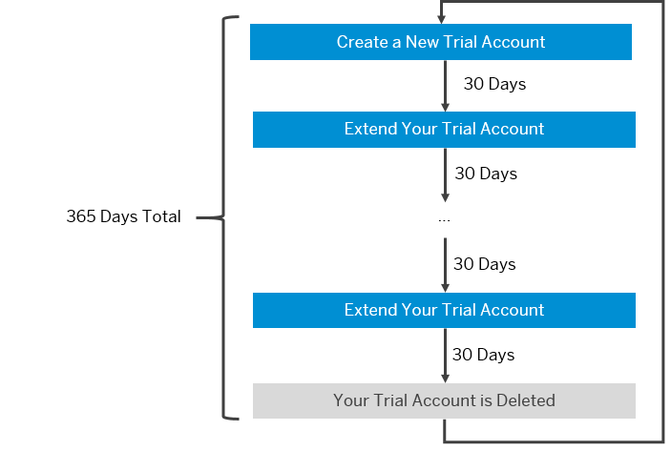
Delete your SAP BTP trial account.
www.anubhavtrainings.com

Slide 14
Delete Trial Account
After 365 days, your trial account is automatically deleted. If you want to proactively delete your SAP BTP trial account, you can navigate to the global accounts scope and select the Account Explorer page, then click the Delete Trial Account button.
If you want to continue to use an SAP BTP trial account, you need to register for a new account.
If you want to explore SAP BTP without time limit, create an enterprise account with free tier service plans allowing you to test your scenarios.
Extend your SAP BTP trial account in 30-day intervals.
www.anubhavtrainings.com

Slide 15
Subaccounts
Subaccounts let you structure a global account according to your organization’s and project’s requirements with regard to members, authorizations, and entitlements.
A global account can contain one or more subaccounts in which you deploy applications, use services, and manage your subscriptions.
www.anubhavtrainings.com

Slide 16
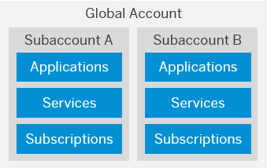
www.anubhavtrainings.com

Slide 17
Ariba
Connects SAP Cloud Integration to the Ariba Network. Using this adapter, SAP and non-SAP cloud applications can receive business-specific documents in commerce eXtensible Markup Language (cXML) format from the Ariba network.
The sender adapter allows you to define a schedule for polling data from Ariba.
www.anubhavtrainings.com

Slide 18
Data Store
Enables SAP Cloud Integration to consume messages from a data store.
www.anubhavtrainings.com

Slide 19
IDOC
Allows SAP Cloud Integration to exchange Intermediate Document (IDoc) messages with a sender system that supports communication via SOAP Web services.
A size limit for the inbound message can be configured for the sender adapter.
www.anubhavtrainings.com

Slide 20
JMS
Enables asynchronous messaging by using message queues.
The sender adapter consumes messages from a queue. The messages are processed concurrently.
To prevent situations where the JMS adapter tries again and again to process a failed (large) message, you can store messages (where the processing stopped unexpectedly) in a dead-letter queue after two retries.
www.anubhavtrainings.com

Slide 21
Odata
Connects SAP Cloud Integration to systems using the Open Data (OData) protocol in either ATOM or JSON format (only synchronous communication is supported).
The adapter receives incoming requests in either ATOM or JSON format.
Supported operations: Create (POST), Delete (DELETE), Query (GET), Read (GET), Update (PUT)
www.anubhavtrainings.com

Slide 22
Open Conne
Connects SAP Cloud Integration to more than 150 non-SAP Cloud applications that are supported by SAP Open Connectors.
Uses APIs to fetch data from specific third-party applications.
Is designed to handle large volumes of incoming data.
Supports messages in both JSON and XML format, for request and response calls.
www.anubhavtrainings.com

Slide 23
Process Direct
Connects an integration flow with another integration flow deployed on the same tenant.
An integration flow with a ProcessDirect sender adapter (as consumer) consumes data from another integration flow.
N:1 cardinality of producer and consumer integration flows is supported.
www.anubhavtrainings.com

Slide 24
SOAP
Exchanges messages with a sender system that supports Simple Object Access Protocol (SOAP) 1.1 or SOAP 1.2.
The message exchange patterns supported by the sender adapter are one-way messaging or request-reply.
The adapter supports Web services Security (WS-Security).
A size limit for the inbound message can be configured for the sender adapter.
SOAP SOAP 1.x
SOAP SAP RM
www.anubhavtrainings.com

Slide 25
HTTPS
Establishes an HTTPS connection between SAP Cloud Integration and a sender system.
www.anubhavtrainings.com

Slide 26
HTTP
Establishes an HTTP connection between SAP Cloud Integration and a receiver system.
Receiver adapter:
Supports HTTP 1.1 only (target system must support chunked transfer encoding and may not rely on the existence of the HTTP Content-Length header)
Supports the following methods: DELETE, GET, HEAD, POST, PUT, TRACE
Method can also be determined dynamically by reading a value from a message header or property during runtime.
www.anubhavtrainings.com

Slide 27
SAP BTP Cockpit
www.anubhavtrainings.com

Slide 28
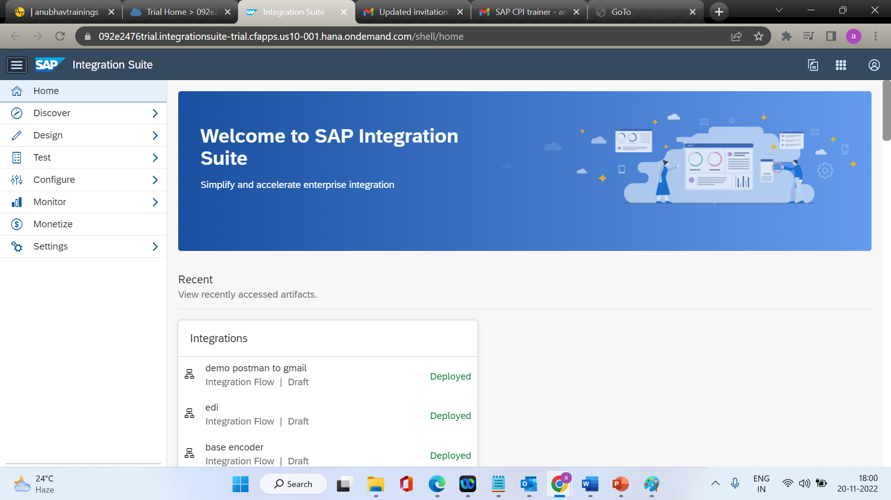
Integration suite
www.anubhavtrainings.com

Slide 29
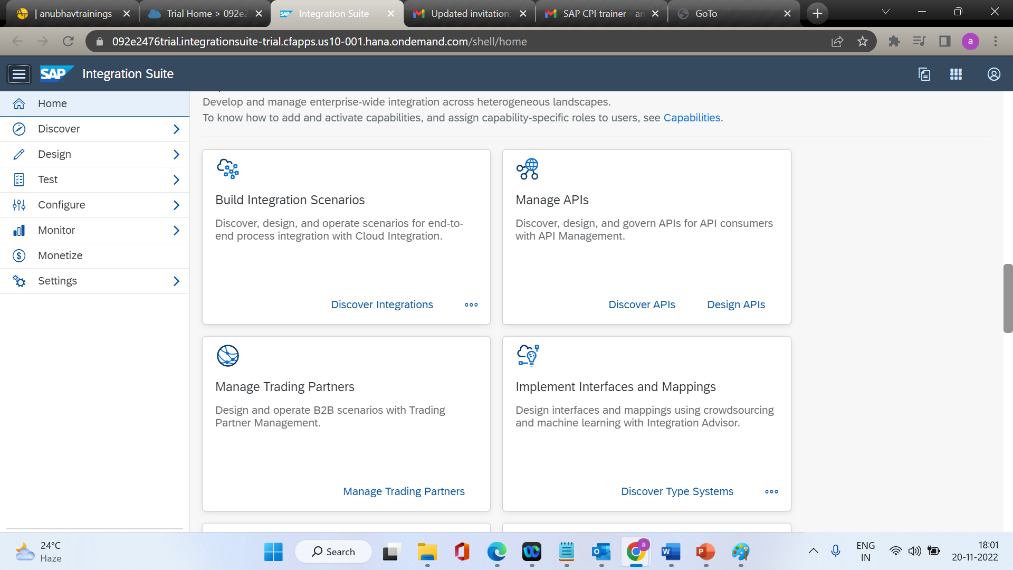

Slide 30
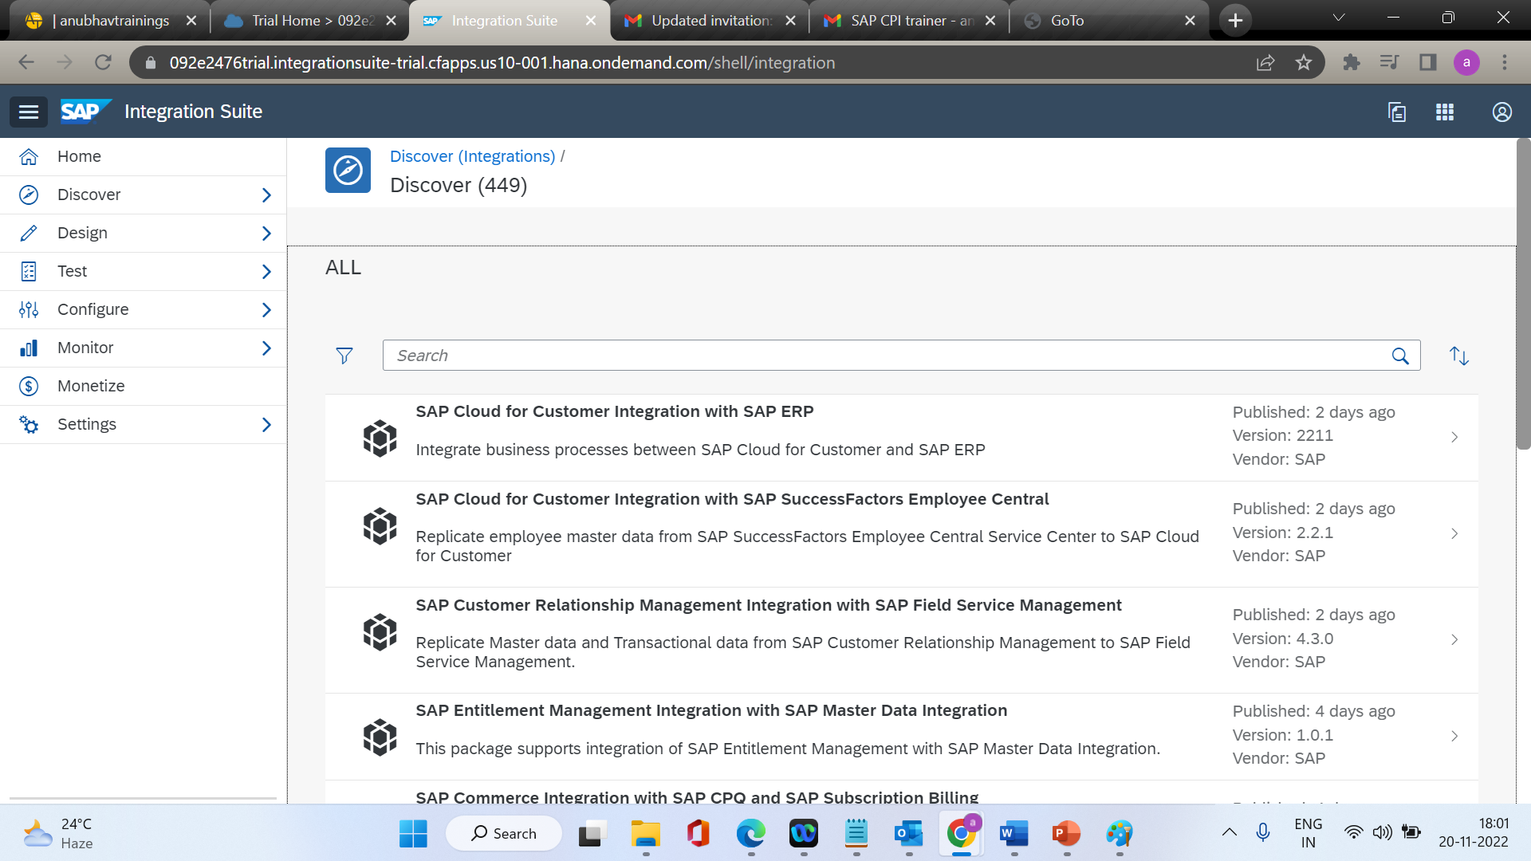

Slide 31
What Is SAP Cloud Integration?
Support end-to-end process integration through the exchange of messages.
SAP Cloud Integration helps you to connect cloud and on-premise applications with other SAP and non-SAP cloud and on-premise applications. This service has the capabilities to process messages in real-time scenarios spanning different companies, organizations, or departments within one organization
www.anubhavtrainings.com

Slide 32
Feature Overview
Core runtime for processing, transformation, and routing of messages to be exchanged between the involved customer systems It is ensured that data related to different customers connected to Cloud Integration is isolated. This is important, for example, when using Cloud Integration for business-to-business scenarios.
Out-of-the-box connectivity support (for example, IDoc, SFTP, SOAP/HTTPS, SuccessFactors, OData, HTTPS)
Security features such as content encryption and certificate-based communication
www.anubhavtrainings.com

Slide 33
Cloud Integration
Cloud Integration offers full flexibility in how messages can be exchanged between customer systems by the following:
Leveraging preconfigured integration patterns. These integration patterns provide different options for configuring the data flow between participants, for example, by using routing rules.
Using various connectivity options. This covers a set of adapters (or endpoint types) that allow participants to connect with different communication protocols to SAP Cloud Integration.
www.anubhavtrainings.com

Slide 34
Cloud Integration Runtime Features
There is a wide range of supported ways how Cloud Integration can process messages and exchanged them with sender and receiver systems (see: Integration Capabilities and Connectivity (Adapters)).
For the delivery of messages received from a sender system Cloud Integration supports quality of service at least once. This means that the platform guarantees to process an inbound message at least once on the tenant. When you use the one of the following adapters, you can configure additional quality of service settings:
www.anubhavtrainings.com

Slide 35
Quality of Service
Quality of Service | Description
At least once | Inbound message is processed at least once by Cloud Integration. If the same message is received multiple times from a sender, all of them are processed. Note This quality of service is supported by all sender adapter types.
Best effort | Inbound message is sent synchronously and an immediate response is given back to the sender system.
Exactly once | Inbound message is processed exactly once by Cloud Integration. If a message with identical message ID (for example, XI message ID) is received multiple times from a sender, only the first one is processed by the sender adapter. The subsequent messages can be identified as duplicates and are not processed. Note In the AS2 sender adapter, duplicate message handling needs to be configured explicitly.
www.anubhavtrainings.com

Slide 36
Mapping
Mapping transforms (maps) the sender into receiver data structures.
In scenarios spanning different application systems or different organizations and enterprises, it is very likely that the structure of the data exchanged between two participants will differ on both sides of a connection due to business-related reasons. To enable a seamless exchange of data, the data structures on both sides of a connection have to be transformed (or: mapped) into each other. There is the option to apply structural mapping of XML documents.
www.anubhavtrainings.com

Slide 37
Using Predefined Integration Content
SAP Cloud Integration allows the participating organizations to develop, deploy, and consume services in a standardized manner. SAP provides a predefined set of integration content that covers most of the integration needs for a particular scenario. Customers can use the predefined integration content to implement their integration scenarios with less time and effort. To accomplish this, however, customers need to register with SAP Cloud Integration and complete the onboarding process as recommended by SAP.
Customers can re-use existing on-premise content (message mappings / operation mappings / XSLT based mappings) from an SAP Enterprise Services Repository (EHP 1 for SAP NetWeaver 7.3).
www.anubhavtrainings.com

Slide 38
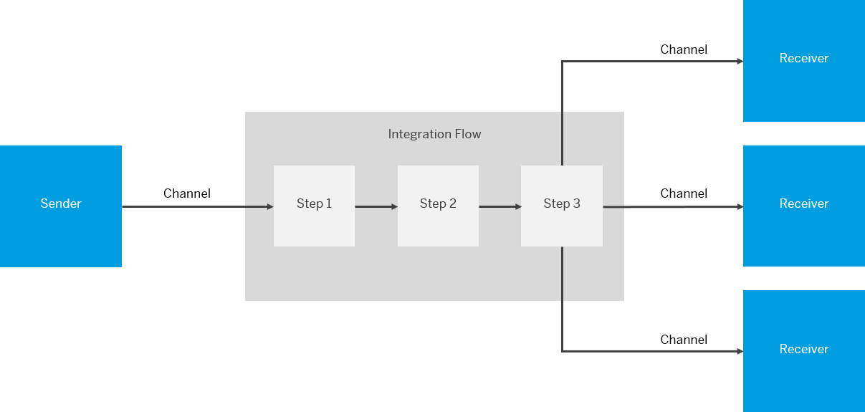
Integration Flows
www.anubhavtrainings.com

Slide 39
Integration flow
An integration flow allows you to specify how a message is processed on a tenant.
The following figure provides a simplified and generalized representation of an integration flow.
www.anubhavtrainings.com

Slide 40
Connecting a Customer System to Cloud Integration
You can set up the technical connection between a tenant and different kinds of remote systems (in many cases located in the customer landscape).
Inbound refers to message processing from a remote system (in many cases, located in the customer landscape) to Cloud Integration. Here, the integration platform is the server.
Outbound refers to message processing from the integration platform to a remote system (where the integration platform is the client).
www.anubhavtrainings.com

Slide 41
Configuring Inbound Communication
Configuring inbound communication means setting up the connection between a remote sender system and the integration platform. Inbound communication refers to message processing from a remote system, often located in the customer landscape, to Cloud Integration. Here, the integration platform is the server
www.anubhavtrainings.com

Slide 42
Sender Systems You Can Connect to the Integration Platform
You can connect different kinds of sender systems to the integration platform, for example:
A cloud application, for example, SAP SuccessFactors
An on-premise application, for example, SAP ERP
A SOAP client
An e-mail server
An SFTP server
www.anubhavtrainings.com

Slide 43
Receiver Systems You Can Connect to the Integration Platform
A cloud application, for example, an SAP cloud application like SuccessFactors or SAP Cloud for Customer
An on-premise application, for example SAP ERP
You can connect on-premise systems (located in the customer system landscape) such as SAP systems. Typical use cases for this are hybrid integration scenarios, where an on-premise SAP application (for example, SAP ERP) is integrated with an SAP cloud application (for example, SAP Cloud for Customer or SAP SuccessFactors).
An e-mail server-In this case, the integration platform sends e-mails to the e-mail server (for an e-mail address specified in the related adapter).
An SFTP server-In this case, the integration platform writes files to the SFTP server.
www.anubhavtrainings.com

Slide 44
Kind of Systems to Connect to Cloud Integration
To give you an idea of which kinds of remote systems can be connected to the integration platform, here are some typical examples (this is not a complete list):
On-premise systems, for example, SAP systems based on SAP NetWeaver
SFTP servers
Cloud applications, for example, SAP SuccessFactors or SAP Cloud for Customer
Other systems such as e-mail servers or SOAP clients
www.anubhavtrainings.com

Slide 45
Overview of the SAP Cloud Integration Web UI
Discover
Design
Monitor
www.anubhavtrainings.com

Slide 46
SAP Cloud Integration Web UI
The SAP Cloud Integration Web UI is your one-stop shop for integration development.
Note that the URL to access the Web UI ends with /its paces.
The Web UI comprises the following sections:
1. Discover
2. Here, you can find predefined integration content provided by SAP that you can use out of the box and adapt to your requirements. As the Getting Started documentation focuses on how to design your own integration content, we do not go into any more detail on this section.
www.anubhavtrainings.com

Slide 47
Integration
Design
This is where you design your integration content. As you progress through the exercise in the Getting Started documentation, you will spend most of your time in this section. It contains the graphical integration flow modeling environment.
Monitor
This is where you can monitor your integration flow. You also use this section to manage additional artifacts that you need to deploy on your tenant to complement your integration flows (for example, User Credential artifacts to configure connections using basic authentication).
www.anubhavtrainings.com

Slide 48
Design Section
Design Section
When you go to the Design section, you find a list of integration packages defined for the tenant.
When you select an integration package, you can find the integration flows (and other artifacts) defined for the package (on the Artifacts tab).
In this Getting Started documentation, we assume that you have not yet defined an integration package for your integration content. Therefore, the first step is to define an integration package.
www.anubhavtrainings.com

Slide 49
Monitor Section
The Monitor section (also referred to as Operations view) has several subsections, each one containing several tiles. These subsections allow you to perform various tasks that are required for an integration project in addition to integration content design.
www.anubhavtrainings.com

Slide 50
Monitor Section
Monitor Message Processing
When you select a tile in this section, you find all messages that have been processed by all integration flows deployed on the tenant. You can find out whether messages have been processed successfully for your integration flow and analyze the situation if not.
Manage Integration Content
When you select a tile in this section, you find all deployed integration flows and can check whether the deployment was successful. You can also find the endpoint address for your integration flow (which you need if you want to configure the endpoint in the connected sender system).
www.anubhavtrainings.com

Slide 51
Manage Security
Manage Security
The Security Material tile contains security-related artifacts that are required on the tenant in addition to the security-relevant settings in your integration flow. In the course of the following exercise, you will create and deploy a User Credentials artifact to define the user name and password for the mail account that is addressed by the Mail receiver adapter of the integration flow.
The Keystore tile shows the content of the tenant keystore, which contains key pairs and certificates required to set up connections that are protected using certificate-based authentication. In the exercise, we need to add certificates when setting up the connection to the e-mail receiver.
The Connectivity Tests (only available in the Neo environment) tile allows you to test outbound connections (from SAP Cloud Integration to a receiver system). We use the connectivity test tool to retrieve the certificates of the e-mail receiver that need to be imported into the tenant keystore.
www.anubhavtrainings.com

Slide 52
Integration Capabilities
Feature | Description
Mapping | Transforms the data structure and format used by the sender into a structure and format that the receiver can process. Supports the following kinds of mappings: Message mappings designed with a graphical editor as part of the Cloud Integration toolset (supports XSD and EDMX structures) Custom-mapping functions defined in scripts XSLT mappings (defined in an XSLT resource)
ID Mapping | Maps the source message ID to a target message ID. You can use this feature to implement scenarios with exactly once processing of messages.
Content Modifier | Modifies the content of an inbound message by changing the header or body of the message. A message is composed of a message body and message headers. Furthermore, when being processed on a Cloud Integration tenant, additional data associated with the message can be passed along in an additional container (referred to as message exchange) to make it available at a later point in time during message processing. The Content Modifier can read data from and write data to the message body, the message header, and the properties area of the message exchange. That way, the content of a message can flexibly be modified and prepared for a receiver or subsequent processing steps. Certain constraints apply with regard to the supported data formats (as described in the product documentation).
Message transformation
www.anubhavtrainings.com

Slide 53
XML Modifier | Modifies the content of an inbound message by removing external DTDs and/or removing XML declarations.
Converter | Transforms an input message into another format. The following converters are available: XML to JSON: Transforms messages in XML format to JSON format. You can specify streaming (with either the whole XML document or only specified XML elements presented by JSON arrays). JSON to XML: Transforms messages in JSON format to XML format. XML to CSV: Transforms messages in XML format to CSV format. CSV to XML: Transforms messages in CSV format to XML format. XML to EDI: Transforms a message in XML format to Electronic Data Interchange (EDI) format. EDI to XML: Transforms a message in EDI format (EDIFACT or ASC-X12 format) to XML format. Certain constraints apply with regard to the supported data formats (as described in the product documentation).
www.anubhavtrainings.com

Slide 54
Decoder | Decodes the incoming message to retrieve the original data (for example, if a base64-encoded message has been received). Base64 Decode: Decodes base64-encoded message content. GZIP Decompress: Decompresses the message content using GNU zip (GZIP). ZIP Decompress: Decompresses the message content using zip (only zip archives with a single entry supported). MIME Multipart Decode: Transforms a MIME multipart message into a message with attachments.
www.anubhavtrainings.com

Slide 55
Converter | Transforms an input message into another format. The following converters are available: XML to JSON: Transforms messages in XML format to JSON format. You can specify streaming (with either the whole XML document or only specified XML elements presented by JSON arrays). JSON to XML: Transforms messages in JSON format to XML format. XML to CSV: Transforms messages in XML format to CSV format. CSV to XML: Transforms messages in CSV format to XML format. XML to EDI: Transforms a message in XML format to Electronic Data Interchange (EDI) format. EDI to XML: Transforms a message in EDI format (EDIFACT or ASC-X12 format) to XML format. Certain constraints apply with regard to the supported data formats (as described in the product documentation).
Decoder | Decodes the incoming message to retrieve the original data (for example, if a base64-encoded message has been received). Base64 Decode: Decodes base64-encoded message content. GZIP Decompress: Decompresses the message content using GNU zip (GZIP). ZIP Decompress: Decompresses the message content using zip (only zip archives with a single entry supported). MIME Multipart Decode: Transforms a MIME multipart message into a message with attachments.
Converter | Transforms an input message into another format. The following converters are available: XML to JSON: Transforms messages in XML format to JSON format. You can specify streaming (with either the whole XML document or only specified XML elements presented by JSON arrays). JSON to XML: Transforms messages in JSON format to XML format. XML to CSV: Transforms messages in XML format to CSV format. CSV to XML: Transforms messages in CSV format to XML format. XML to EDI: Transforms a message in XML format to Electronic Data Interchange (EDI) format. EDI to XML: Transforms a message in EDI format (EDIFACT or ASC-X12 format) to XML format. Certain constraints apply with regard to the supported data formats (as described in the product documentation).
www.anubhavtrainings.com

Slide 56
Decoder | Decodes the incoming message to retrieve the original data (for example, if a base64-encoded message has been received). Base64 Decode: Decodes base64-encoded message content. GZIP Decompress: Decompresses the message content using GNU zip (GZIP). ZIP Decompress: Decompresses the message content using zip (only zip archives with a single entry supported). MIME Multipart Decode: Transforms a MIME multipart message into a message with attachments.
www.anubhavtrainings.com

Slide 57
Encoder | Encodes the message using an encoding scheme to secure any sensitive message content during transfer over the network. Base64 Encode Encodes the message content using base64. GZIP Compress: Compresses the message content using GNU zip (GZIP). ZIP Compress: Compresses the message content using zip (only zip archives with a single entry supported). MIME Multipart Encode: Transforms the message content into a MIME multipart message. If you want to send a message with attachments, but the protocol (for example, HTTP or SFTP) does not support attachments, you can send the message as a MIME multipart instead. Note Note that SAP Cloud Integration does not support the processing of MIME multipart messages that contain multiple attachments with the same file name.
www.anubhavtrainings.com

Slide 58
Filter | Filters information by extracting a specific node from the incoming message by using an XPath expression.
Message Digest | Calculates a digest of the payload or parts of it and stores the result in a message header.
Script | Executes custom Java script or Groovy script for message processing.
www.anubhavtrainings.com

Slide 59
Calling External Systems or Subprocesses
Feature | Description
Request-Reply | Calls an external receiver system in a synchronous step and gets back a response.
Send | Calls an external receiver system for use cases where no reply is expected.
Content Enricher | Calls an external system, accesses resources of this system, and merges the returned content with the original message.
Poll Enrich Step | Polls content from an external component, and enriches the original message with it.
Process Call | Calls a local integration process. A local integration process defines a container for a separate subprocess to be called from the main process. Using local integration processes, a complex message processing sequence can be fragmented and decomposed into smaller parts.
Looping Process Call | Calls a local integration process in a loop.
Idempotent Process Call | Detects if a message ID has already been successfully processed and stores the status of the successful process in the idempotent repository. If there's duplicate execution with the same message ID (for example if there’s a retry by the sender system), the called subprocess can either be skipped or the message is marked as a duplicate. You can then decide how to handle the duplicate in the subprocess.
www.anubhavtrainings.com

Slide 60
Routing
Description
Routes a message to one or more receivers. SAP Cloud Integration also supports routing that depends on the content of the message (content-based routing). For example, the tenant detects that a message has a particular field value, and forwards it to the specific receiver participant that handles requests from the sender participant.
Sends the same message to more than one receiver. Parallel multicast: Initiates message transfer to all the receiver nodes in parallel Sequential multicast: defines the sequence in which the message transfer to the receivers is initiated.
Decomposes a composite message into a series of individual messages and sends them to a receiver. Supported splitters: General splitter: Breaks down a composite message containing ‘n’ messages into ‘n’ individual messages. Each individual message is enveloped by the same elements that enveloped the composite message. Iterating splitter: Splits a composite message into a series of smaller messages without copying the enveloping elements of the composite message PKCS#7/CMS splitter: Splits a PKCS7 Signed Data message that contains a signature and content (and breaks down the signature and content into separate files) IDoc splitter: Splits a composite IDoc messages into a series of individual IDoc messages with the enveloping elements of the composite IDoc message EDI splitter: Splits a bulk EDI message into a series of individual messages and validates and acknowledges the inbound message. A bulk EDI message can contain one or more EDI formats, such as EDIFACT, EANCOM, or ASC-X12. The EDI splitter can process different EDI formats depending on the business requirements of the trading partners. Zip splitter: Splits an inbound archive file (.zip) into individual files. Certain constraints apply with regard to the supported data formats (as described in the product documentation).

Slide 61
Join | Merges messages from different routes and combines them into a single message. This feature is used in combination with the Gather feature. Join simply brings together the messages from different routes; it doesn't affect the content of the messages. Certain constraints apply with regard to the usage of this feature (as described in the product documentation).
Gather | Merges messages from different routes (into a single message) with the option to define certain strategies how to combine the initial messages.
www.anubhavtrainings.com

Slide 62
Storing Data During Processing
Feature | Description
Persist Message | Stores a message payload so that you can access the stored message and analyze it at a later point in time.
Data Store Operations | Stores messages temporarily for later processing. The following operations are supported: SELECT GET WRITE DELETE
Write Variables | Specifies values for variables required during message processing.
www.anubhavtrainings.com

Slide 63
Protecting Messages
Description
Encrypts the content of a message. Supported standards: PGP PKCS#7/CMS Enveloped Data and Signed Data
Decrypts the content of a message. Supported standards: PGP PKCS#7/CMS Enveloped Data and Signed Data
Signs a message. Supported standards: PKCS#7/CMS Enveloped Data and Signed Data XML Digital Signature
www.anubhavtrainings.com

Slide 64
Verifier | Verifies a message. Supported standards: PKCS#7/CMS Enveloped Data and Signed Data XML Digital Signature
www.anubhavtrainings.com

Slide 65
Monitor
Message processing
Manage integration content
Manage security
Manage store
www.anubhavtrainings.com

Slide 66
Message processing
The message monitor provides an overview of the messages processed on a tenant and allows you to display the details for individual messages.
You open the message monitor by clicking a tile in the Monitor Message Processing area.
Messages are displayed according to the filter settings of the tile.
www.anubhavtrainings.com

Slide 67
Filter Setting
Filter Settings
You can control which messages are displayed by changing the filter.
You can filter messages by Time, Status, and Artifact.
www.anubhavtrainings.com

Slide 68
Filter Attributes
Attribute | Description
Time | Allows you to select from the following predefined time intervals: All Past Minute Past Hour Past 24 Hours Past Week Past Month Custom You can select the start and end time of the interval. The specified time interval is displayed above the message list. When you browse different pages of the message monitor, the time interval stays the same. You can only modify the time interval by changing the filter settings or by refreshing the message monitor (applies to all-time intervals except for Custom).
Status | Allows you to filter messages according to their status. In the dropdown list you can select one of the following values as the status: All Failed Retry Completed Processing Escalated Cancelled Discarded Abandonded
Artifact | Allows you to display messages associated with specific artifacts. The value help list contains all artifacts and packages for which Message Processing Logs might exist. When you position the cursor on an artifact in the value help list, name and type are displayed and the tooltip shows additional information. When you select one of the following entries in the value help list, you can also filter for all artifacts with a dedicated type: All Integration Flows All OData APIs All SOAP APIs All REST APIs You can filter for artifacts with a specific sequence of characters in their name or ID. The search is case insensitive.
www.anubhavtrainings.com

Slide 69
Filter Settings
Go to Use More Fields to display addition filter criteria, such as:
Sender
Receiver
Custom Status
Application Message Type
Custom Header
A value help is available for the Sender, Receiver, Custom Status, and Application Message Type fields. The list of available values depends on your integration design.
www.anubhavtrainings.com

Slide 70
Messages Table
Messages Table
The messages for the selected filter settings are displayed in a table under Messages. If the number of filtered messages exceeds 50, the list is split over several pages (each page containing a maximum of 50 messages). You can browse through the different pages by selecting the corresponding navigation options (Show first data page, Show last data page, Show previous data page, and Show next data page).
Alternatively, you can enter a page number to navigate to a specific page of the list.
The following attributes are displayed for each message:
www.anubhavtrainings.com

Slide 71
Message Table
Message Attributes in Message Overview
Attribute | Description
Artifact Name | Display name of the artifact (for example, the name of the integration flow that specifies the message processing).The tooltip shows the technical name, the artifact, and the package name.
Status | Status of end-to-end message processing.
Last Updated at | Time at which the message processing log was last updated.
Processing Time | Total message processing time.
www.anubhavtrainings.com

Slide 72
Logs
Logs
Displays the Log Level and the Runtime Node. Clicking the log level link takes you to the message processing log displayed in table form. You access the textual representation by selecting Open Text View.
If the processing of an integration flow failed and retry runs were performed, the runs are displayed in a table (up to 50 retries) in the Logs section.
If Data Archiving is activated for logs of an integration artifact, the archiving status is displayed in this section. The status are:
Not Archived:Data Archiving is not activated for logs of this integration artifact.
Data Archiving does not consider logs of discarded message processing.
Data Archiving is configured to consider logs of successfully completed messages only.
Archiving Pending: Data Archiving is activated for logs of this integration artifact.
Archived: Data Archiving is completed for this log.
www.anubhavtrainings.com

Slide 73
Attachments
This section is only displayed if the message processing log contains attachments.
Any type of attachment that can be displayed as text is supported. In particular, the following types of content can be displayed:
Plain text
XML
XML attachments are displayed as formatted plain text (including tags).
Text files with comma-separated values
Text files with tab-separated values
In these files, each entry is represented as one line of the text file.
HTML
HTML attachments are displayed as plain text (including tags).
www.anubhavtrainings.com

Slide 74
Artifact Details
This section displays the artifact Name, ID, Type, and Package, if available. You can open the integration flow by clicking the View Deployed Artifact link. To edit the integration flow model, click the Navigate to Artifact Editor link. You can also navigate to the Integration Content Monitor by selecting the Manage Integration Content link. You will get a list of all artifacts matching the ID-string displayed in the search field.
www.anubhavtrainings.com

Slide 75
Message Status
Message Status
Status | Description
COMPLETED | Message has been delivered to receiver successfully.
PROCESSING | Message is currently being processed.
RETRY | Status retry is set if an error occurred during message processing, and a retry was automatically started.
ESCALATED | During message processing an error occurred, and no retry has been triggered. For synchronous messages, an error message is sent to the sender.
FAILED | Message processing failed, message hasn’t been delivered to receiver, and no retries are possible. In other words: FAILED is a final status, and message processing ultimately has failed.
CANCELLED | Manual cancellation of entries in the JMS queue - MPL is set to status cancelled.Note In general, the last final status is accepted, but if the message processing is still ongoing, and the status CANCELLED is set, it’s overwritten by another "final status" such as COMPLETED, after completion of the message processing.
DISCARDED | For scheduler triggered integration flows, the MPL is shown on the worker node where the message processing started first. For all subsequent message processing starts, the message status is set to DISCARDED.For example, assume that an integration flow is initiated by a Timer event (scheduler) and a worker node goes into an out of memory state. The system starts the worker node again and synchronizes the integration flow as soon as the node is active. The message is restarted in that case, and a new message ID generated. The message with the original ID goes into status DISCARDED.
ABANDONDED | Message processing was interrupted or log wasn't updated for an uncommonly long time. The status can change in case processing is resumed.Note When the message processing is interrupted because of a re- or undeployment of an integration flow, or a controlled worker node shutdown, the MPL is immediately set to ABANDONDED. This status isn’t final and the processing can be resumed if retries are configured. If there are hard worker node crashes, the status is changed to ABANDONDED by an asynchronous system job, after some time of inactivity
www.anubhavtrainings.com

Slide 76
Message Status
Status of Aggregated Messages
Status | Description
PROCESSING | Is set as soon as the aggregation process is started and remains as long as the aggregate is still open for further messages. Note that this status can in many situations be shown for quite some time (even days) – depending on the applied aggregation use case.
FAILED | Is set when the aggregated message (after aggregation process has successfully been finished) fails.
RETRY | Is set when the aggregated message (after aggregation process has successfully been finished) runs into an error and sending it’s retried.
www.anubhavtrainings.com

Slide 77
Message Processing Log
The message processing log displays structured information of a message.
Select a message from the list. In the view section, the header shows the integration flow name, the processing date and the time of its last update.
www.anubhavtrainings.com

Slide 78
Message Processing Logs
The logs section shows the number of runs as well as the following information:
Runs
Property | Description
# | Displays the sequential number of the run
Started At | Displays the date and time of the last run.
Duration | Displays the duration of the processing run in ms.
Log Level | Displays the log level.
Process ID | Displays the ID of the worker node on which the run was executed.
Status | Displays the intermediate status of the message processing log after this run.
www.anubhavtrainings.com

Slide 79
Envelope Icons
www.anubhavtrainings.com

Slide 80
Setting Log Levels
The log level for the message processing log specifies the granularity of information collected by the message processing log
You can set the log level for an integration flow scenario in the Manage Integration Content page of the Web-based Monitor.
Select your integration flow in the Manage Integration Content and set the log level for this integration flow in the Log Configuration section.
www.anubhavtrainings.com

Slide 81
Setting Log Level
Log Level | Description
None | No data is recorded during message processing and no data is shown in data monitoring.Note In case data archiving is available on your tenant and configured for your integration flow, no data is archived for this specific integration flow.
Info | Basic information is recorded during message processing. The header is always displayed.If there are failed messages, the message processing log retains and displays additional detailed information about the last 50 message steps.
Error | The message processing log records basic information for failed message executions only. The message processing log retains and displays detailed information about the last 50 message steps. Use this log level, if you've no interest in recording completed messages.No message processing log attachments are recorded. Note In case data archiving is available on your tenant and configured for your integration flow, no data is archived for this specific integration flow. Specifics for log level Error: If you've defined a retry-scenario in your integration flow and set log level Error, a final successful retry isn't recorded. In particular, the overall Message Processing Log Status stays in status Retry or Failed although the message is finally successfully delivered.
Debug | Caution As the log level Debug is a high resource consuming feature, we recommend setting log level Debug only in a development or test environment! The message processing log records detailed information for all steps during message processing. While all steps (with headers and additional information) are accessible in the graphical UI, only the last 100 are shown in the text view of the message processing log. The log level debug expires after a certain period of time. After expiry, the log level switches back to the log level set before. Note in the Neo environment, the expiry time can be set in the Tenant Configuration. To request an extension of the expiry time, open a ticket on the component LOD-HCI-PI-OPS. In the Cloud Foundry environment, the expiry time is fixed and set to 24 hours.
Trace | Caution As in the NEO environment , the log level Trace is a high resource consuming feature, we recommend setting log level Trace only in a development or test environment! SAP can disable this function for a specific tenant or adjust expiry and retention time. The message processing log records detailed information for all steps during message processing and additionally tracks the message content. The trace function expires after a certain period of time (default value: 10 minutes). After expiry, the log level switches back to the log level set before. The recorded message content is also only retained for a certain time (default value: 1 hour) Specifics for log level Trace:If the downloaded trace data, such as header value size and exchange properties exceed 10000 characters, they're truncated.
www.anubhavtrainings.com

Slide 82
Managing Integration Content
The Manage Integration Content section provides an overview of integration content artifacts, such as integration flows, that have been deployed on the tenant.
In the Manage Integration Content area, a set of tiles is displayed that show the number of deployed integration content artifacts for a particular type (for example, Integration Flow) and with a particular status (for example, Started). You can configure each tile to filter by a different artifact type or status, or both. To do this, position the cursor on a tile and choose Edit from the context menu.
www.anubhavtrainings.com

Slide 83
Deployment of Integration Adapter
To deploy an integration adapter, choose  . In the pop up, select Browse to choose an integration adapter from the files listed,(the standard file extension for integration adapters is .esa). Name, ID, and Version are filled in automatically.
On the right side of the screen, more details about the artifact selected on the left side are shown. Depending on the artifact type,other functions can be accessed as well.
www.anubhavtrainings.com

Slide 84
The header area provides the following information about the selected artifact:
The header area also provides certain functions (the available functions depend on the type of the selected artifact):
Restart
Allows you to restart an artifact (for example, an integration flow that has been stopped on the node).
Undeploy
Allows you to undeploy an active integration flow.
Integration Content Details
Information | Description
Deployed on | Time when the artifact was deployed.
Deployed by | User who deployed the artifact.
Version | Version of the artifact, for example, the integration flow version.
ID | Artifact ID
Package | Name of the package the artifact was deployed from.
Mode(if applicable) | Indicates whether it is configure-only content.
www.anubhavtrainings.com

Slide 85
Deployment
The header area also provides certain functions (the available functions depend on the type of the selected artifact):
Restart
Allows you to restart an artifact (for example, an integration flow that has been stopped on the node).
Undeploy
Allows you to undeploy an active integration flow.
Download
Allows you to download the artifact to your computer.
Endpoints
Shows the URLs of the services exposed by the artifact for a sending application. You can copy the URL by choosing the Copy button
www.anubhavtrainings.com

Slide 86
Manage Integration Content
Artifact Details
The type of the selected artifact determines which kind of information is displayed.
www.anubhavtrainings.com

Slide 87
Artifact Details
Artifact Details
Artifact Type | You can:
Integration flows | access the Monitor Message ProcessingView deployed artifact Navigate to Artifact Editor
Value mapping | View deployed artifactNavigate to Artifact Editor
SOAP API | access the Monitor Message ProcessingView deployed artifact Navigate to Artifact Editor
REST API | access the Monitor Message ProcessingView deployed artifact Navigate to Artifact Editor
OData API | access the Monitor Message ProcessingNavigate to Artifact Editor
Integration Adapter | access the Vendor
Script Collection | View deployed artifactNavigate to Artifact Editor
Message Mapping | View deployed artifactNavigate to Artifact Editor
www.anubhavtrainings.com

Slide 88
Status
Runtime Status
Indicates if a deployed artifact is ready to operate.
The following status values are possible.
www.anubhavtrainings.com

Slide 89
Statuses
Status | Description
Started | The artifact is ready to be used. An artifact with this status is in a final state.
Error | The artifact requires attention by the user (administrator). An artifact with this status is in a final state.
Starting | The artifact is in the process of being deployed on the worker node(s) and, if deployed, is being started. An artifact with this status is in an intermediate state.
Stopping | The artifact is in the process of being stopped on the worker node(s) and, if stopped, is being undeployed. An artifact with this status is in an intermediate state. During the process of undeployment, the artifact has status Stopping. An artifact with this status cannot be restarted, undeployed or downloaded.
www.anubhavtrainings.com

Slide 90
Managing Security
The Manage Security section allows you to manage various kinds of security material (for example, user credentials, keystore entries), and to perform outbound connectivity tests.
www.anubhavtrainings.com

Slide 92
Managing Security Material
Managing Security Material
The Manage Security Material area provides an overview of security-related artifacts.
You open the Manage Security Material area with the following actions:
Click the tile Security Material.
Security artifacts with the corresponding status (of the tile) are displayed.
www.anubhavtrainings.com

Slide 93
Attributes of Security-Related Artifacts
Attribute | Description
Name | Display name of the artifact
Type | Possible values:User Credentials For User Credentials artifacts (a tooltip indicates the kind of the artifact). OAuth2 Credentials OAuth2 Authorization Code Secure ParameterFor Secure Parameter artifacts (a tooltip indicates the kind of the artifact). Known Hosts (SSH) PGP Public Keyring PGP Secret Keyring
Status | Displays the state with regard to the artifact deployment. This status indicates whether an artifact has been deployed successfully on a tenant or whether it still needs to be authorized. Possible values: StoredNote Refresh the list to see the current status. Deployed Error Unauthorized (for OAuth2 Authorization Code)
Deployed By | User who deployed the artifact
Deployed On | Time when the artifact was deployed
www.anubhavtrainings.com

Slide 94
Managing Keystore Entries
The Keystore Monitor allows a tenant administrator to manage the tenant keystore and its entries (X.509 certificates and key pairs).
A keystore typically contains entries that belong to the tenant administrator (customer) and entries that are owned by SAP. Each entry is uniquely identified by an alias.
The operations you can perform on a keystore entry depend on whether it's owned by SAP or the tenant administrator. You (as tenant administrator) can, for example, only delete or back up entries that are owned by the tenant administrator. Vice versa, SAP can't access or download any keystore entries owned by the tenant administrator.
www.anubhavtrainings.com

Slide 95

Keystore
The following GIF gives you a brief overview of the Keystore tile and its functions:
www.anubhavtrainings.com

Slide 96
Managing Stores
The Manage Stores section allows you to manage various temporary data storages on your tenant.
Managing Data Stores
Managing Variables
Managing Message Queues
Managing Number Ranges
www.anubhavtrainings.com

Slide 97
Managing Data Store
The Manage Stores section provides an overview of storages on the tenant, which are temporarily used to persist data of different kind during message processing.

Slide 98
Managing Variables
The Variables view allows you to monitor variables used in integration flows.
www.anubhavtrainings.com

Slide 99
Managing Message Queues
Certain adapters allow you to store messages in queues. Using the Web UI, you can monitor queues that are active for a tenant.
www.anubhavtrainings.com

Slide 100
Managing Number Ranges
The topic provides an overview of number ranges related artifacts.
You choose the Number Ranges tile in the Manage Stores area to view the artifacts with the corresponding status.
www.anubhavtrainings.com

Slide 101
Agenda
Discover
Standard package – search ,Advantage
Copy
Export’,import
Update package
Edit
Delete
Custom package- Custom Flow
How to create package and IFlow
Version change
Renaming of iflow
Real time usage of Pallet Functions
Local Integration Flow
Sender
Receiver
Timer
Start Message
End Message
Content Modifier- Header, Property and Body
Monitoring
Log Level – Info, Trace, Error , Debug
www.anubhavtrainings.com

Slide 102
Integration Suite
Integration suit
CPI or ci
Discover - package/iflow -
Design – dev -
Monitoring- Monitor message processing-
Manage integration content –
Security
Mange store – data store jms
www.anubhavtrainings.com

Slide 103
Discover
In the Discover tab, you will the list of packages containing the standard Integration Scenarios in the form of Integration Flow that has been created and released by SAP. Now, these Integration Flows/ IFlows/ Artifacts can be in 2 forms, a) configurable, or b) editable
Here, you can find predefined integration content provided by SAP that you can use out of the box and adapt to your requirements. As the Getting Started documentation focuses on how to design your own integration content, we do not go into any more detail on this section.
www.anubhavtrainings.com

Slide 104
Integration suite
Cloud Integration allows you to assemble integration contents into packages so that integration developers can use these packages in their integration scenarios.
As an integration developer, you can now create integration packages for your specific domain or organization. You can also view different packages published by other integration developers and consume them for your integration purposes. You can modify these packages based on your requirements and upload them through the web application.
www.anubhavtrainings.com

Slide 105
Creating an Integration Package
Create an integration package that is specific to your integration scenario.
Procedure
Choose Design.
Choose Create.
In the Header tab, provide a Name, a Technical Name, and a Short Description for the package.
Choose Save to keep your package.
Navigate to other tabs of the package to explore what else you can do with the package.
www.anubhavtrainings.com

Slide 106
Importing Integration Packages
Upload your existing integration packages that suits your integration scenario to reduce redundancy and duplication efforts of creating a package from scratch.
Procedure
Choose Design Import.
Importing a new version of a package (zip import) over an existing package doesn't overwrite the configured values of the externalized parameters in the existing package
Browse and select the integration package for uploading.
Choose OK
www.anubhavtrainings.com

Slide 107
Working with an Integration Package
Procedure
Choose Design to view the list of integration packages.
If you want to view the details of an integration package, choose <integration package name>.
Navigate to the Artifacts tab, to work with the available artifacts in the package.
Choose  View metadata to view the metadata of the artifact.
Choose  Deploy to deploy the artifact.You can only deploy data flows, integration flows, and value mappings. You can deploy multiple value mappings at a time.
Choose  Configure to configure the artifact.You can configure only integration flows. For more information, see Configure Externalized Parameters of an Integration Flow.
Choose  Download to download an artifact. The download feature allows users to download the integration flow artifact with two options:
Default Values Only: Downloads the integration flow with default values only.
Merged Configured and Default Values: Downloads the integration flow with values that consists of configured and default values. This option would replace the default value with the configured value and accept it as a new default value.
www.anubhavtrainings.com

Slide 108
Editing an Integration Package
Procedure
Choose Design to view the list of integration packages.
Select the required integration package.
In the integration package editor, choose Edit.
You can edit the existing information in the following tabs:
Header
Overview
Artifacts
Documents
Tags
In the Header tab, you can maintain the name of the package, a short description, a version, and the vendor of the package.
All this data is displayed on top of the integration package. Furthermore, in the list of integration packages within your design workspace, the name, the short description, and the version are displayed.
www.anubhavtrainings.com

Slide 109
Updates for SAP's Integration Packages
SAP provides preshipped content to address various integration scenarios. You can copy these integration packages from the Discover section to the Design space. SAP also publishes updates with new enhancements and bug fixes.
Whenever there's an update (planned or available) for the content that you've copied into your workspace, you're informed by a label that is displayed below your corresponding artifact.
There are two modes through which the package update is done:Manual
Automatic
Immediate
Scheduled
www.anubhavtrainings.com

Slide 110
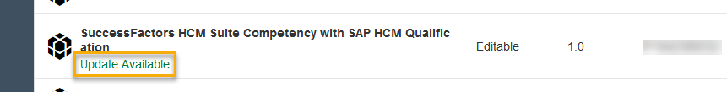
Manual
If you've copied a package into your Design space and an update is available, only then Update Available label appears next to the package name.
www.anubhavtrainings.com

Slide 111
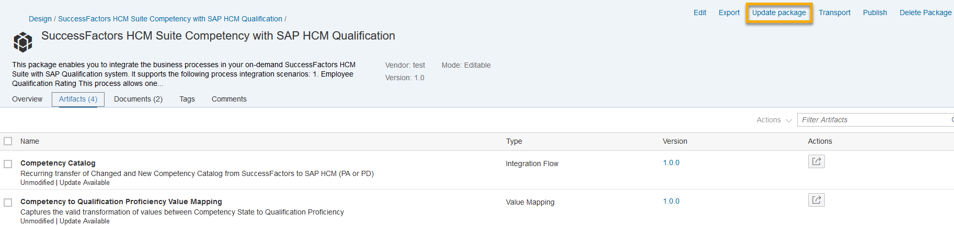
Open the package and choose Update Package.
www.anubhavtrainings.com

Slide 112
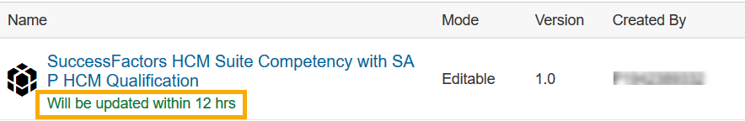
Automatic
If the content is set to update automatically , the update of the packages in the Design space happens in one of two ways.
Automatic Update - Immediate
The package gets updated within 12 hours. Updates are pushed immediately when the update includes important bug fixes. These packages have the label Will be updated within 12 hrs next to their names
www.anubhavtrainings.com

Slide 113
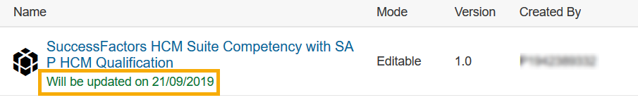
Automatic Update - Scheduled
The content of the package is set to be updated on a particular date as configured during publication. Packages that are scheduled to update automatically have the label Will be updated on <date>.
www.anubhavtrainings.com

Slide 114
Note
If an artifact is already deployed on the tenant, and an automatic update is released for that content package, the automatic update process also updates the deployed instance of the artifact in addition to the stored instance in the Design view.
www.anubhavtrainings.com

Slide 115
Post Update
Post Update
After successful update, the updated packages display the last modified details next to the package names, and the design-time artifacts are replaced with the new updated content.
If the artifacts contain previously deployed content, the update procedure triggers the deployment of the new design-time content. If the deployment of updated design-time content fails, then the system retries the deployment three times with an interval of 1 hour. With every iteration, if the deployment fails, the artifact is rolled back to the previously deployed runtime version.
If this happens, your tenant contains content with a newer version of the design time, as there's no rollback of the design time content to an older version.
You need to manually deploy the newly updated design-time content. If the manual deployment also fails, contact your tenant administrator with the relevant log details of the issue.
www.anubhavtrainings.com

Slide 116
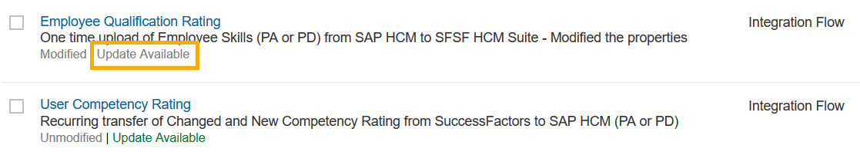
Updates for Edited Content
We recommend to only configure the standard integration content.
In some scenarios, you can customize the content according to your needs. But once the artifact is modified, it does no longer receive any updates. Such artifacts appear with the grayed-out label of Update Available.
www.anubhavtrainings.com

Slide 117
Note
Package update only updates the content of the package. All attributes and configured externalized parameters of the package maintained by the user are retained.
Updates are available even if the packages are renamed.
A renamed artifact does no longer receive any updates.
www.anubhavtrainings.com

Slide 118
Exporting Integration Packages
Download your integration packages to your local system, so that you can provide it to your content management team to upload and publish them. Publishing integration packages makes them available on SAP API Business Hub
Procedure
Choose Design to view the list of integration packages.
Select the required integration package.
Choose Export.By default, the downloaded file takes the name of the integration package. In case the name contains special characters, the browser changes the file name by appending them. The destination of export depends on the default browser setting.
Note
Configure-only content can't be downloaded.
www.anubhavtrainings.com

Slide 119
Backup and Restore Your Integration Artifacts
Context
Download all the artifacts of a package in one go, using which you can create a local backup of all artifacts. Later, you can upload the downloaded resources in another package or tenant based on your requirements
www.anubhavtrainings.com

Slide 120
Procedure
Open your integration package and choose Edit.
Download all artifacts
Choose the Artifacts tab.
Select the checkbox besides the column header Name to select all the integration artifacts in the package. Alternatively, you can select only the artifacts that you would like to download.
Choose Actions Download.A .zip file with filename same as the integration package's name is ready for download.
Save the file to your choice of destination
www.anubhavtrainings.com

Slide 121
To upload the downloaded artifacts in another package or tenant, continue with the below steps.
Choose Design.
Choose Import.
Browse and select a .zip file
www.anubhavtrainings.com

Slide 122

SAP Cloud Integration
Training
ON THE
SAP BUSINESS TECHNOLOGY PLATFORM
Date: Dec 12th, 2022
Time: 9:00AM IST
Facilitator: Anu
www.anubhavtrainings.com

Slide 123
Agenda
Logs
Info
Error
Debug
Trace
Iflow basics
Integration Capabilities
Message transformation
Converters
Decoder
Encoder
Filter
Calling external system or Subprocess
Decomposes a composite message into a series of individual messages and sends them to a receiver
Join and Gather
Storing data During processing
Protecting messages
Smoke test Basic iflow – hello world
Smoke Test Scenario with External Data Source

Slide 124
Basic Concepts of Integration Design
www.anubhavtrainings.com

Slide 125
Elements of an Integration Flow
An integration flow allows you to specify how a message is processed on a tenant.
You can use integration flows to specify specific integration patterns like mapping or routing.
A graphical editor allows you, the integration developer, to model the message processing steps and specify in detail what happens to the message during processing.
In detail, you define the following aspects in an integration flow:
The senders and receivers of the message
How the senders and receivers are connected to the tenant (adapters)
The steps that define the message processing
The following figure provides a simplified and generalized representation of an integration flow.
www.anubhavtrainings.com

Slide 126
www.anubhavtrainings.com

Slide 127
Senders and Receivers
You define a participant of an integration scenario as a sender or receiver. The senders and receivers typically represent the customer systems that are connected to the tenant and exchange messages with each other.
Connectivity (Adapters)
An integration flow channel allows you to specify which technical protocols should be used to connect a sender or a receiver to the tenant.
www.anubhavtrainings.com

Slide 128
Message Processing (Steps)
You use integration flow steps to specify what should happen to a message during processing. Various step types support the wide range of integration capabilities of the Cloud-based integration platform.
Message Flows
You use message flows to connect various integration flow elements.
www.anubhavtrainings.com

Slide 129
Updating your Existing Integration Flow
Some new features might not be available for your current integration flow due to the following reason:
A feature for a particular adapter or step was released after you created the corresponding shape in your integration flow.
You have the following options:
You can continue using the older version of the integration flow shape (adapter or step).
You can use the new integration flow shape (adapter or step).
To do this, you first have to delete the old flow step or channel and then create it again.
www.anubhavtrainings.com

Slide 130
Adapting Standard Integration Content to Your Requirements
When you use standard (predefined) integration content published on SAP API Business Hub, there are two different ways how to adapt such content to meet the requirements of your concrete business scenario.
Modifying/editing the standard integration flow
Configuring externalized integration flow parameters
www.anubhavtrainings.com

Slide 131
Modifying/Editing the Standard Integration Flow
Using this option, you modify the integration flow in Edit mode and change its design, for example, by adding new integration flow steps or channels. Modifying an integration flow this way allows you also to change parameter values predefined in the integration flow model.
However, be aware of the fact that when using this option you can run into conflicts when SAP provides an update of the associated integration package. Note that as soon as you've modified a predefined integration flow, you don’t get any further updates to it when SAP provides an update of the related integration package. Furthermore, if you copy an updated standard integration package from SAP API Business Hub to the Design workspace of your tenant, you overwrite all changes that you have made to that package before this action.
www.anubhavtrainings.com

Slide 132
Configuring Externalized Integration Flow Parameters
When you use a predefined integration flow, it’s likely that certain parameters are defined as externalized parameters. When having copied an integration package from SAP API Business Hub to the Design workspace of your tenant, you have the option to configure the values of externalized integration flow parameters. Choosing this option allows you to adapt the integration flow without the need to modify the integration flow model in Edit mode.
Typically, the integration developer who provides the standard integration flow has externalized parameters such like, for example, address parameters of adapters. Such parameters typically can't be foreseen by the provider of the standard integration package. The reason is that the values of such parameters depend on the concrete environment and system landscape where the integration flow is finally to be deployed. To enable the integration flow to run in a dedicated environment, such parameters anyway need to be adapted by the consumer of the standard integration package
www.anubhavtrainings.com

Slide 133
Versioning of Artifacts
Cloud Integration offers an easy version management capability for your integration artifacts.
You can version both the integration package and its artifacts and documents.
When editing an artifact, you can either choose Save as Version to save your changes. Choose Save to save your artifact as Draft version. Choose Save as Version to create a new version of the artifact. In this case, you can specify the version in the upcoming Version Information dialog. In the Comment section, you can add additional information specific to the artifact for later reference. This helps you determine the purpose of each versio
www.anubhavtrainings.com

Slide 134
By default, artifact versions follow the versioning convention of <major>.<minor>.<micro>. Although Cloud Integration does not prevent you from maintaining any version number, it is recommended to follow this convention. In combination with a well-defined versioning policy,
thie measure helps you to understand to which extent changes of the package or artifact were done.
www.anubhavtrainings.com

Slide 135
Examples
Example
If you add a new integration flow step to an existing integration flow, increase the micro version, for example, from version 1.0.1 to 1.0.2.
If you enhance an integration flow with a further integration process or an exception subprocess, increase the minor version,for example, from version 1.0.1 to 1.1.0.
If you have updated an existing integration flow within an integration package, increase the micro version of the package.
If you have added a new integration flow to an integration package, increase the minor version of the package.
www.anubhavtrainings.com

Slide 136
By default, you only see the latest version of the artifact in the integration package. However, the older versions of the artifact are available for you in the backend. If you want to switch to a different version of that artifact, you can do that by selecting the version and choosing the  icon corresponding to the version. This feature allows you to replace integration content of the current version with the selected version.
www.anubhavtrainings.com

Slide 137
Examples
Example
You are currently using the 1.2.0 version of the artifact, but you want to switch to version 1.1.8. You click on the version number 1.2.0, and in the Version History dialog, you choose  icon next to 1.1.8 to replace the integration content of the 1.2.0 version with 1.1.8 version.
You can choose More to see comments about each version, if any.
www.anubhavtrainings.com

Slide 138
Connecting a Customer System to Cloud Integration
Inbound refers to message processing from a remote system (in many cases, located in the customer landscape) to Cloud Integration. Here, the integration platform is the server.
Outbound refers to message processing from the integration platform to a remote system (where the integration platform is the client).
www.anubhavtrainings.com

Slide 139
Smoke Test Scenario
This is a very simple test to verify that your SAP Cloud Integration is working as expected. You do not need any receiver system to perform this test.
In this scenario, you create a Hello World text and write it into the message body (scheduled on deployment of the integration flow). The result is written into the message processing log which you can directly inspect with the message monitoring application.
www.anubhavtrainings.com

Slide 140
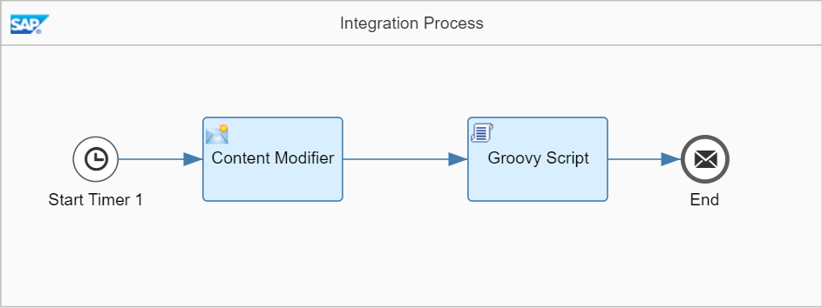
www.anubhavtrainings.com

Slide 141
To make it as easy as possible for you to develop this first integration flow, you don't need to configure any sender system. That saves the effort for you to set up a dedicated sender system and to connect it to SAP Cloud Integration. Instead of this, message processing is triggered by a Timer event, and the inbound message payload is created within the integration flow, in a dedicated Content Modifier step.
Furthermore, it is also not required that you set up any receiver system. To enable you to check if the message has been processed correctly, you will configure the integration so that the message payload is written into the message processing log (where you can easily inspect it using the Monitor application of the Web UI).
www.anubhavtrainings.com

Slide 142
This is how the integration flow will process the message at runtime:
The Timer event triggers the processing of the message (according to the settings of the Timer's scheduler).
The Content Modifier step creates a message with a simple text content (Hello World!).
The Groovy Script step logs the payload of the message (that means, it writes the message content into the message processing log).
When you have finished the integration flow design, you save and deploy the integration flow.
You can then monitor message processing.
www.anubhavtrainings.com

Slide 143
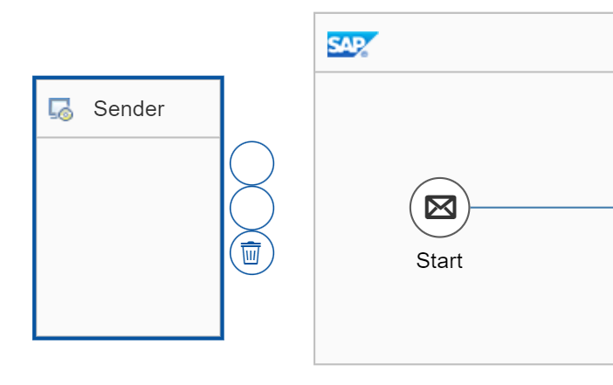
Add a Timer Start Event
Open the integration flow model (Edit mode), select the Sender shape, and choose
the recycle bin icon (to remove the Sender shape
www.anubhavtrainings.com

Slide 144
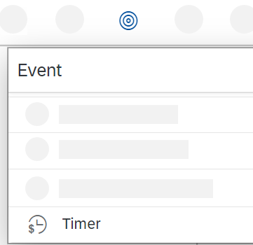
In the same way, remove the Start event.
In the palette, select the Events entry, and then select the Timer shape.
www.anubhavtrainings.com

Slide 146
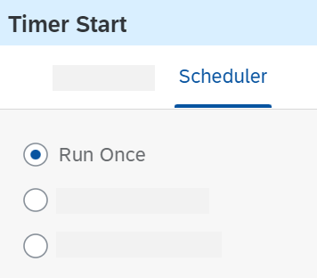
Place the Timer shape in the Integration Process shape (at the point where the Start event was previously located).
In the properties section of the Timer event (displayed below the integration flow model when the Timer event is selected in the model), go to the Scheduler tab.
www.anubhavtrainings.com

Slide 147
Make sure that the option Run Once is selected.
www.anubhavtrainings.com

Slide 148
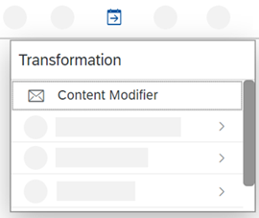
Create a Content Modifier to Define the Message Body
Add a Content Modifier step to create the message body.
As the integration flow has no sender, we use a Content Modifier to create a message from scratch.
To add a Content Modifier, go to the palette, choose the Message Transformers icon, and select the Content Modifier icon.
www.anubhavtrainings.com

Slide 149
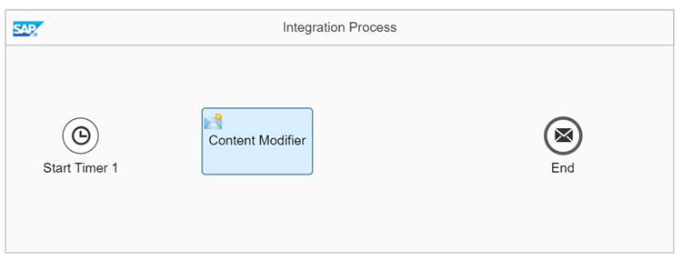
Place the Content Modifier in the model after the Timer Start event.
www.anubhavtrainings.com

Slide 150
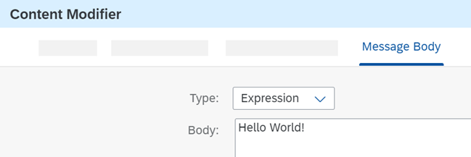
In the Content Modifier properties section, go to the Message Body tab and enter the following string sequence in the entry field:
Hello World!
www.anubhavtrainings.com

Slide 151
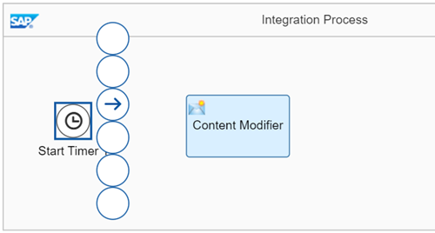
This simulates the inbound XML message.
Connect the Timer event with the Content Modifier. To do this, select the Timer event.
www.anubhavtrainings.com

Slide 152
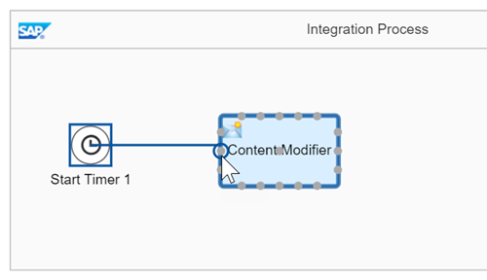
Click the arrow icon, and drag and drop the cursor to the Content Modifier.
www.anubhavtrainings.com

Slide 153
Create a Script Step to Log the Payload
Add a Script step to log the message payload.
With a Groovy Script step, you can configure the integration in such a way that the payload of the message is written to the message processing log as attachment.
To add a Script step (containing a Groovy script), go to the palette and choose the Message Transformers icon and select the Script icon.
www.anubhavtrainings.com

Slide 154
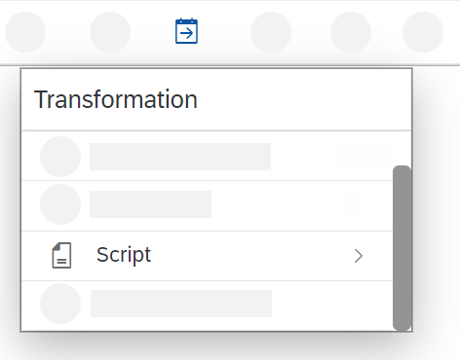
www.anubhavtrainings.com

Slide 155
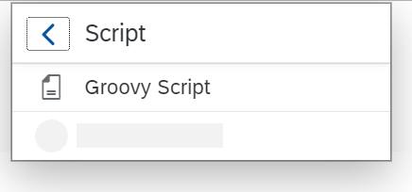
In the Script submenu, select Groovy Script.
www.anubhavtrainings.com

Slide 156
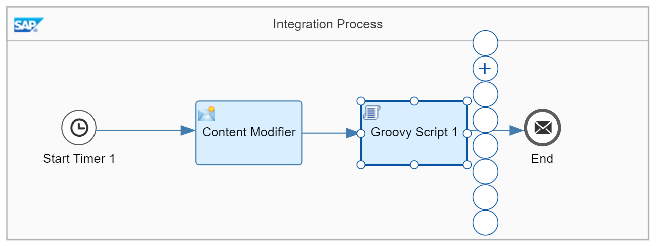
Place the Script step shape after the Content Modifier step and connect both shapes.
Select the Script step.
The context icons are displayed.
www.anubhavtrainings.com

Slide 157
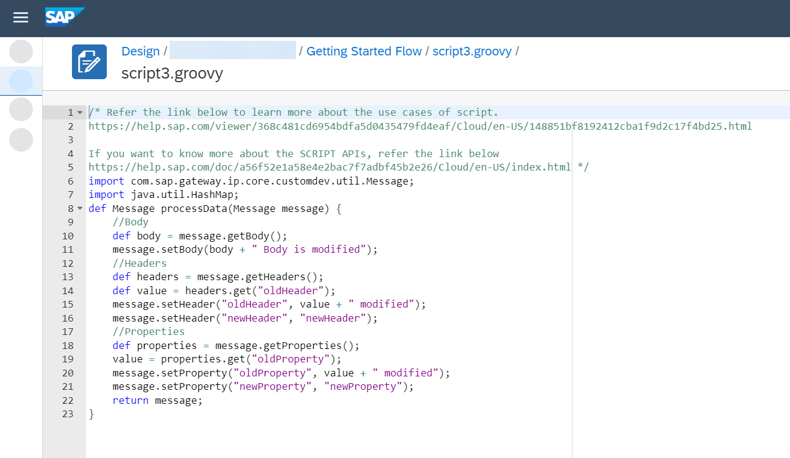
Choose the + icon.
The default script coding of the step is displayed.
www.anubhavtrainings.com

Slide 158
Replace this content by the script provided in the coding example below.
import com.sap.gateway.ip.core.customdev.util.Message;
import java.util.HashMap;
def Message processData(Message message)
{
def body = message.getBody(java.lang.String) as String;
def messageLog = messageLogFactory.getMessageLog(message);
if(messageLog != null)
{
messageLog.addAttachmentAsString("Log current Payload:", body, "text/plain");
}
return message;
}
www.anubhavtrainings.com

Slide 159
Choose OK.
www.anubhavtrainings.com

Slide 160
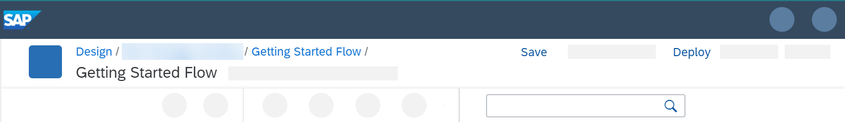
Save and deploy the integration flow on the tenant to process it.
When you've finished modeling the integration flow, select Save.
www.anubhavtrainings.com

Slide 161
Once saving has been successful, a corresponding status message is displayed.
Select Deploy.
A message is displayed that asks you to confirm this action.
Select Yes.
Another message is displayed when the validation has been performed and the integration flow deployment has been triggered.
Select OK.
After successful deployment, a status message is displayed.
www.anubhavtrainings.com

Slide 162
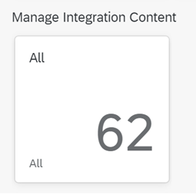
Choose the Operations view to check the status of the deployment.
Select a tile in the section Manage Integration Content.
www.anubhavtrainings.com

Slide 163
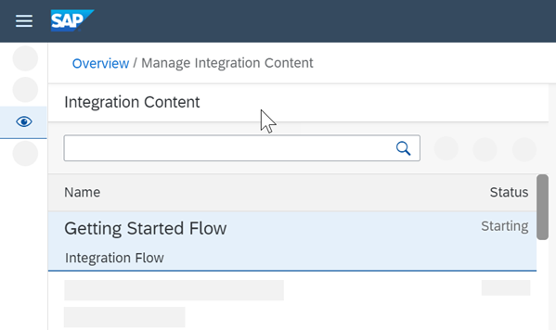
You can check the deployment status of your integration flow. You can check the deployment status of your integration flow.
www.anubhavtrainings.com

Slide 164
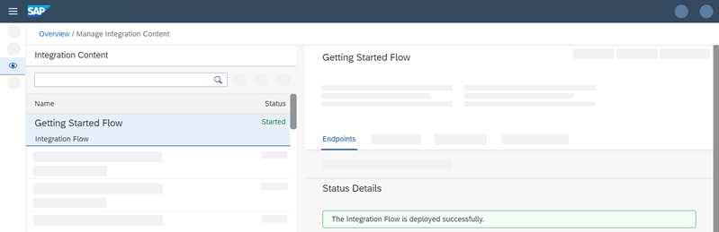
It changes from Starting to Started.
www.anubhavtrainings.com

Slide 165
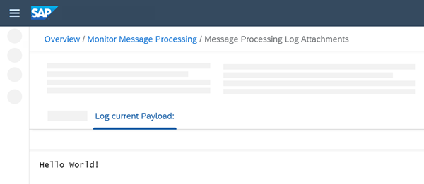
When the integration flow has been deployed successfully, the message is processed without any further trigger (based on the settings of the timer).
Go to the Operations view and select a tile under Monitor Message Processing.
If your integration flow has been processed successfully, the status Completed should be shown.
Select the integration flow and analyze the details area to the right of the integration flow list.
Under Attachments, click Log current Payload.
You should see the message content, which consists of the following text:
Hello World!
www.anubhavtrainings.com

Slide 166
Smoke Test Scenario with External Data Source
This is a very simple test to verify that your SAP Cloud Integration is working as expected. You do not need any receiver system to perform this test.
In this scenario, you access an OData API and get information about a product (for a specific product ID). The result is written into the message processing log which you can directly inspect with the message monitoring application.
www.anubhavtrainings.com

Slide 167
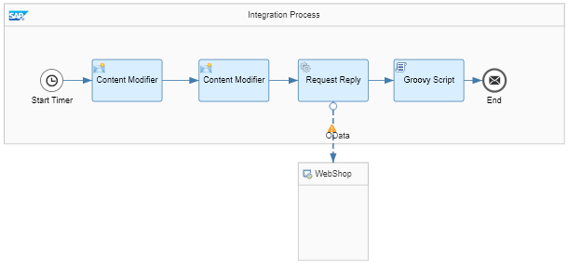
In the course of this exercise, you develop the following integration flow.
www.anubhavtrainings.com

Slide 168
To make it as easy as possible for you to develop this first integration flow, you don't need to configure any sender system. That saves the effort for you to set up a dedicated sender system and to connect it to SAP Cloud Integration. Instead of this, message processing is triggered by a Timer event, and the inbound message payload is created within the integration flow, in a dedicated Content Modifier step.
www.anubhavtrainings.com

Slide 169
Integration Flow
This is how the integration flow will process the message at runtime:
The Timer event triggers the processing of the message (according to the settings of the Timer's scheduler).
The first Content Modifier step creates a message with only one element, a productIdentifier (to identify a product from the product catalog).
The actual value of the productIdentifier is hard-coded in this step. If you like to process the integration flow with another product identifier, you need to change the value in this step and re-deploy the integration flow again. This is the drawback which results from abstaining from a dedicated sender system.
The second Content Modifier creates a message header (which we also call productIdentifier) and writes the actual value of the productIdentifier element into it. This header will be used in the subsequent step.
The Request Reply step passes over the message to an external data source and retrieves data (about products) from there.
The external data source is represented by the lower WebShop shape.
The external data source supports the Open DataProtocol (OData). For our scenario, we use the ESPM WebShop, which is based on the Enterprise Sales and Procurement Model (ESPM) provided by SAP.
For the connection to the WebShop, an OData receiver channel is used. To query for exactly one product (for the product identifier provided with the inbound message), the header that has been created in the preceding Content Modifier is used.
The OData API provides the details of one specific product (according to the product identifier provided with the inbound message).
The Groovy Script step logs the payload of the message (that means, it writes the message content into the message processing log).
You can then run the integration flow and monitor message processing as described under:
www.anubhavtrainings.com

Slide 170
Content Modifier
Create a Content Modifier to Define the Message Body
Add a Content Modifier step to create the message body.
As the integration flow has no sender, we use a Content Modifier to create a message from scratch.
To add a Content Modifier, go to the palette, choose the Message Transformers icon, and select the Content Modifier icon.
www.anubhavtrainings.com

Slide 171
Content Modifier
Place the Content Modifier in the model after the Timer Start event.
In the Content Modifier properties section, go to the Message Body tab and enter the following string sequence in the entry field:
Sample Code
<root> <productIdentifier>HT-1080</productIdentifier> </root>
www.anubhavtrainings.com

Slide 172
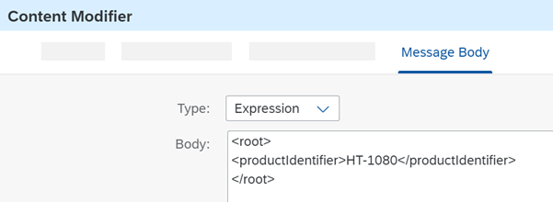
Content Modifier
This simulates the inbound XML message.
www.anubhavtrainings.com

Slide 173
Content Modifier
Connect the Timer event with the Content Modifier. To do this, select the Timer event, click the arrow icon, and drag and drop the cursor to the Content Modifier.
www.anubhavtrainings.com

Slide 174
Create a Content Modifier to Add a Header
www.anubhavtrainings.com

Slide 175
Content Modifier
Add a Content Modifier to your model to define a header, which will be used in a later step to filter data from the external source.
If you remember, our input message has only one field: productIdentifier. This field will contain a product identifier that we want to use to filter the results from the
WebShop application.
To make this number available to the integration framework during message processing, SAP Cloud Integration provides the option to store the value of productIde
ntifier from the incoming message either in the message header or in a data container referred to as an exchange property.
We use the first option, and to prepare the message accordingly we use a Content Modifier.
Add a second Content Modifier (after the first one) to the integration flow model.
In the properties section of the second Content Modifier, go to the Message Header tab and choose Add.
Specify the following parameters:
Name: Enter any name, for example, productIdentifier. This is the name of the header that will be created by the Content Modifier step.
Type: Select XPath.
www.anubhavtrainings.com

Slide 176
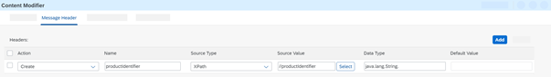
Data Type: Enter java.lang.String.
Value: Enter //productIdentifier (which is the XPath expression that points to the productIdentifier field in the inbound message)
www.anubhavtrainings.com

Slide 177
Create the Outbound OData Channel
Connect the first Content Modifier (which defines the message body) with the second one.
www.anubhavtrainings.com

Slide 178
To call the external data source, add a Request Reply step to the integration flow model and connect this step with the external system using an OData channel.
o configure SAP Cloud Integration to send a request message to the external OData API (to retrieve the required data), you need to do the following:
Create a Request Reply step.
Connect the Request Reply step to a Receiver shape and select the OData adapter type.
Configure the OData adapter to specify how the OData API of the external service should be called (to define query options, for example).
www.anubhavtrainings.com

Slide 179
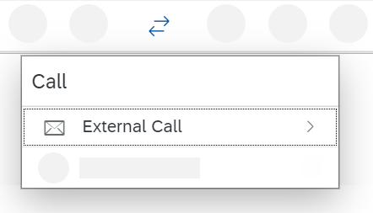
Go to the palette and select the Call entry.
www.anubhavtrainings.com

Slide 180
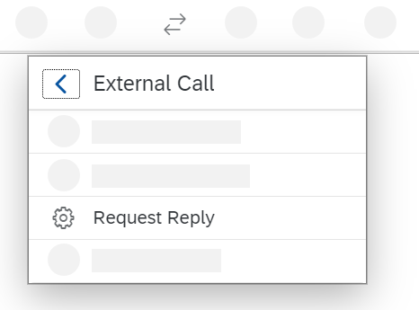
Select External Call and in the submenu choose Request Reply.
www.anubhavtrainings.com

Slide 181
Place the Request Reply shape between the second Content Modifier and the End event in the model.
Furthermore, connect the second Content Modifier with the Request Reply step and the Request Reply step with the End event.
Move the Receiver shape closer to the Request Reply shape (below the Request Reply shape but outside the Integration Process shape, as shown in the overall integration flow model under Smoke Test Scenario with External Data Source).
Connect the Request Reply shape to the Receiver shape (by selecting the Request Reply shape, clicking the arrow icon, and dragging and dropping the cursor on the Receiver shape).
In the next dialog, choose adapter type OData OData V2.
In the next dialog, as Message Protocol select OData V2.
www.anubhavtrainings.com

Slide 182
Go to the Connection tab of the OData adapter and enter the following as Address:
https://refapp-espm-ui-cf.cfapps.eu10.hana.ondemand.com/espm-cloud-web/espm.svc
www.anubhavtrainings.com

Slide 183
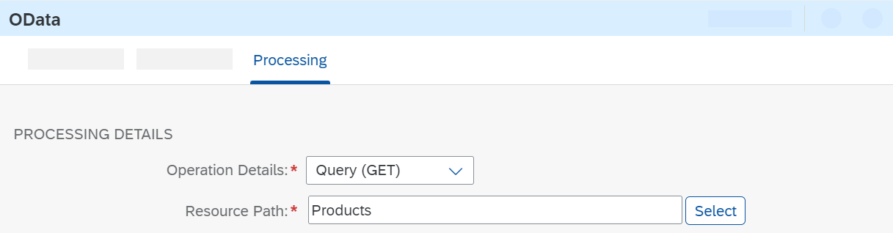
Go to the Connection tab of the OData adapter and enter the following as Address:
https://refapp-espm-ui-cf.cfapps.eu10.hana.ondemand.com/espm-cloud-web/espm.svc
Go to the Processing tab.
Next to Resource Path, choose Select.
www.anubhavtrainings.com

Slide 184
In the Query Editor opens, you can conveniently define the OData query.
The Address field is already populated with the value you just entered.
Make sure that Remote is selected as the Connection Source, and choose Step 2.
The system connects to the WebShop service and retrieves the metadata from its OData API.
Choose the search icon in the Select Entity field.
www.anubhavtrainings.com

Slide 185
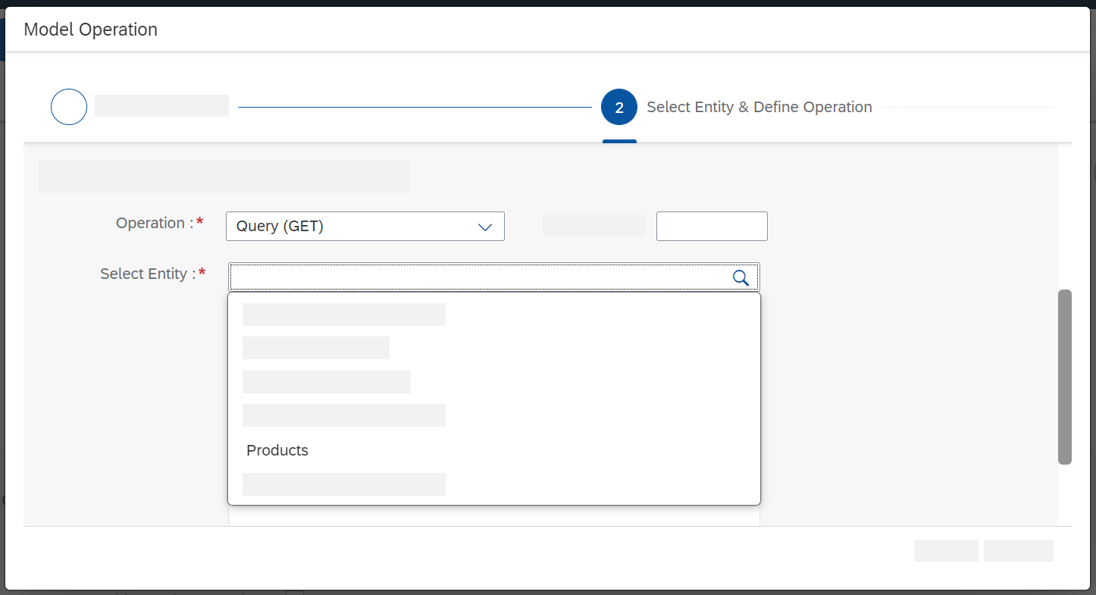
www.anubhavtrainings.com

Slide 186
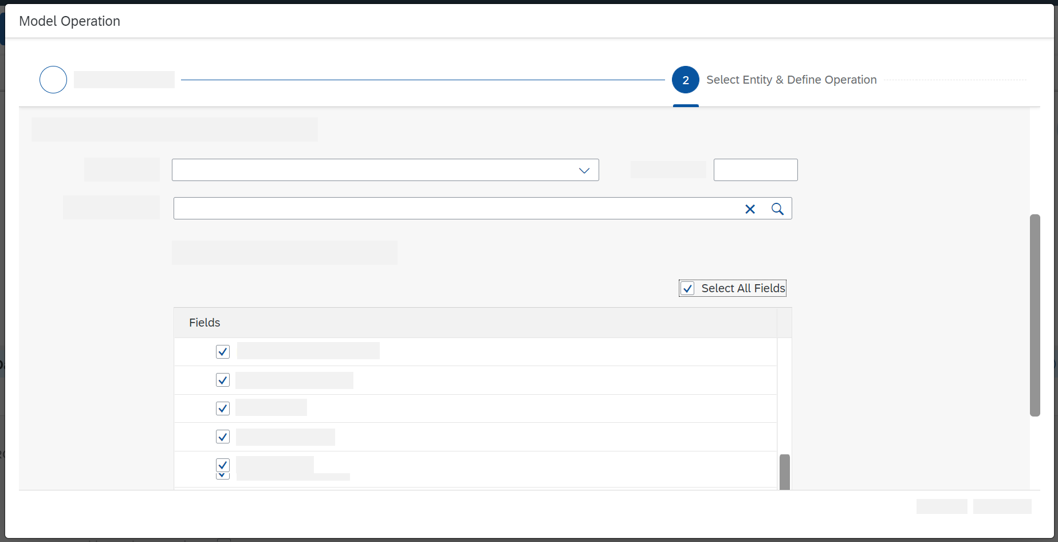
Select Products.
A list of the available elements is provided, using the information from the OData API.
Choose a set of elements for which you want to retrieve data (for example, all elements, as shown in the next figure) and choose Step 3.
www.anubhavtrainings.com

Slide 187
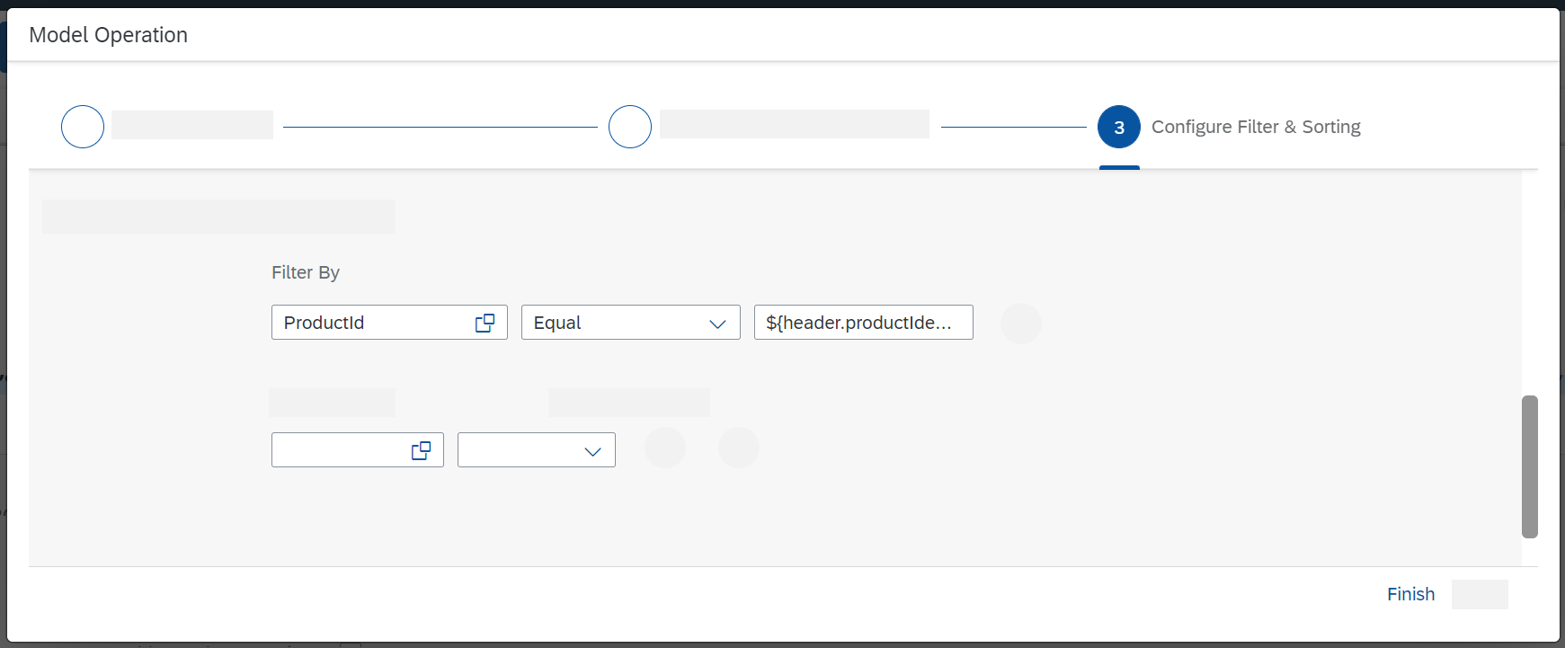
Choose the copy icon in the Filter By field and select ProductId.
Select Equal.
In the third field, enter an expression that allows the integration framework to access the message header productIdentifier that you created in the preceding Content Modifier step: ${header.productIdentifier}.
www.anubhavtrainings.com

Slide 188
Create the Script Step to Log the Payload
Add a Script step to log the message payload.
With a Groovy Script step, you can configure the integration in such a way that the payload of the message is written to the message processing log.
To add a Script step (containing a Groovy script), go to the palette and choose the Message Transformers icon and select the Script icon.
www.anubhavtrainings.com

Slide 189
In the Script submenu, select Groovy Script.
www.anubhavtrainings.com

Slide 190
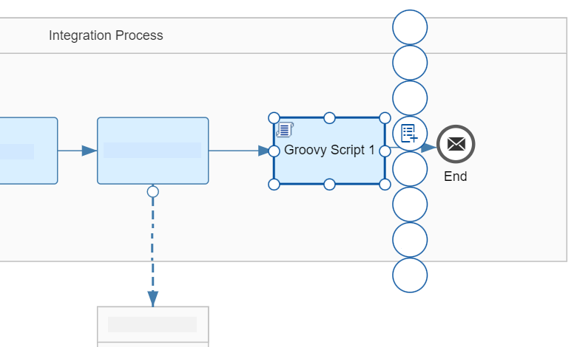
Place the Script Step shape after the Request Reply step and connect both shapes.
Select the Script step.
The context icons are displayed.
www.anubhavtrainings.com

Slide 191
Choose the + icon.
The default script coding of the step is displayed.
www.anubhavtrainings.com

Slide 192
import com.sap.gateway.ip.core.customdev.util.Message;
import java.util.HashMap;
def Message processData(Message message)
{
def body = message.getBody(java.lang.String) as String;
def messageLog = messageLogFactory.getMessageLog(message);
if(messageLog != null)
{
messageLog.addAttachmentAsString("Log current Payload:", body, "text/plain");
}
return message;
}
www.anubhavtrainings.com

Slide 193
Choose OK.
The integration flow model is again displayed.
Save and deploy the integration flow.
www.anubhavtrainings.com

Slide 194
Run the Integration Flow and Monitor the Message Processing
Run the integration flow and check the result of message processing.
When the integration flow has been deployed successfully, the message is processed without any further trigger (based on the settings of the timer).
When you have saved and deployed your integration flow, check the deployment status. Go to the Monitor section of the Web UI and select a tile under Manage Integration Content.
As soon as deployment has finished, the status Started should be displayed for your integration flow.
Go back to the overview page of the Web UI Monitor section and select a tile under Monitor Message Processing.
If your integration flow has been processed successfully, the status Completed should be shown.
Select the integration flow and analyze the details area to the right of the integration flow list.
Under Attachments, click Log current Payload.
You should see the message content, which consists of the details of the product associated with the value of productIdentifier entered in the first Content Modifier.
This shows you that the message has been processed correctly.
www.anubhavtrainings.com

Slide 195
Envelope Icons
www.anubhavtrainings.com

Slide 196
Setting Log Levels
The log level for the message processing log specifies the granularity of information collected by the message processing log
You can set the log level for an integration flow scenario in the Manage Integration Content page of the Web-based Monitor.
Select your integration flow in the Manage Integration Content and set the log level for this integration flow in the Log Configuration section.
www.anubhavtrainings.com

Slide 197
Setting Log Level
Log Level | Description
None | No data is recorded during message processing and no data is shown in data monitoring.Note In case data archiving is available on your tenant and configured for your integration flow, no data is archived for this specific integration flow.
Info | Basic information is recorded during message processing. The header is always displayed.If there are failed messages, the message processing log retains and displays additional detailed information about the last 50 message steps.
Error | The message processing log records basic information for failed message executions only. The message processing log retains and displays detailed information about the last 50 message steps. Use this log level, if you've no interest in recording completed messages.No message processing log attachments are recorded. Note In case data archiving is available on your tenant and configured for your integration flow, no data is archived for this specific integration flow. Specifics for log level Error: If you've defined a retry-scenario in your integration flow and set log level Error, a final successful retry isn't recorded. In particular, the overall Message Processing Log Status stays in status Retry or Failed although the message is finally successfully delivered.
Debug | Caution As the log level Debug is a high resource consuming feature, we recommend setting log level Debug only in a development or test environment! The message processing log records detailed information for all steps during message processing. While all steps (with headers and additional information) are accessible in the graphical UI, only the last 100 are shown in the text view of the message processing log. The log level debug expires after a certain period of time. After expiry, the log level switches back to the log level set before. Note in the Neo environment, the expiry time can be set in the Tenant Configuration. To request an extension of the expiry time, open a ticket on the component LOD-HCI-PI-OPS. In the Cloud Foundry environment, the expiry time is fixed and set to 24 hours.
Trace | Caution As in the NEO environment , the log level Trace is a high resource consuming feature, we recommend setting log level Trace only in a development or test environment! SAP can disable this function for a specific tenant or adjust expiry and retention time. The message processing log records detailed information for all steps during message processing and additionally tracks the message content. The trace function expires after a certain period of time (default value: 10 minutes). After expiry, the log level switches back to the log level set before. The recorded message content is also only retained for a certain time (default value: 1 hour) Specifics for log level Trace:If the downloaded trace data, such as header value size and exchange properties exceed 10000 characters, they're truncated.
www.anubhavtrainings.com

Slide 198
Integration Capabilities
Feature | Description
Mapping | Transforms the data structure and format used by the sender into a structure and format that the receiver can process. Supports the following kinds of mappings: Message mappings designed with a graphical editor as part of the Cloud Integration toolset (supports XSD and EDMX structures) Custom-mapping functions defined in scripts XSLT mappings (defined in an XSLT resource)
ID Mapping | Maps the source message ID to a target message ID. You can use this feature to implement scenarios with exactly once processing of messages.
Content Modifier | Modifies the content of an inbound message by changing the header or body of the message. A message is composed of a message body and message headers. Furthermore, when being processed on a Cloud Integration tenant, additional data associated with the message can be passed along in an additional container (referred to as message exchange) to make it available at a later point in time during message processing. The Content Modifier can read data from and write data to the message body, the message header, and the properties area of the message exchange. That way, the content of a message can flexibly be modified and prepared for a receiver or subsequent processing steps. Certain constraints apply with regard to the supported data formats (as described in the product documentation).
Message transformation

Slide 199
XML Modifier | Modifies the content of an inbound message by removing external DTDs and/or removing XML declarations.
Converter | Transforms an input message into another format. The following converters are available: XML to JSON: Transforms messages in XML format to JSON format. You can specify streaming (with either the whole XML document or only specified XML elements presented by JSON arrays). JSON to XML: Transforms messages in JSON format to XML format. XML to CSV: Transforms messages in XML format to CSV format. CSV to XML: Transforms messages in CSV format to XML format. XML to EDI: Transforms a message in XML format to Electronic Data Interchange (EDI) format. EDI to XML: Transforms a message in EDI format (EDIFACT or ASC-X12 format) to XML format. Certain constraints apply with regard to the supported data formats (as described in the product documentation).

Slide 200
Decoder | Decodes the incoming message to retrieve the original data (for example, if a base64-encoded message has been received). Base64 Decode: Decodes base64-encoded message content. GZIP Decompress: Decompresses the message content using GNU zip (GZIP). ZIP Decompress: Decompresses the message content using zip (only zip archives with a single entry supported). MIME Multipart Decode: Transforms a MIME multipart message into a message with attachments.
www.anubhavtrainings.com

Slide 201
Converter | Transforms an input message into another format. The following converters are available: XML to JSON: Transforms messages in XML format to JSON format. You can specify streaming (with either the whole XML document or only specified XML elements presented by JSON arrays). JSON to XML: Transforms messages in JSON format to XML format. XML to CSV: Transforms messages in XML format to CSV format. CSV to XML: Transforms messages in CSV format to XML format. XML to EDI: Transforms a message in XML format to Electronic Data Interchange (EDI) format. EDI to XML: Transforms a message in EDI format (EDIFACT or ASC-X12 format) to XML format. Certain constraints apply with regard to the supported data formats (as described in the product documentation).
Decoder | Decodes the incoming message to retrieve the original data (for example, if a base64-encoded message has been received). Base64 Decode: Decodes base64-encoded message content. GZIP Decompress: Decompresses the message content using GNU zip (GZIP). ZIP Decompress: Decompresses the message content using zip (only zip archives with a single entry supported). MIME Multipart Decode: Transforms a MIME multipart message into a message with attachments.
Converter | Transforms an input message into another format. The following converters are available: XML to JSON: Transforms messages in XML format to JSON format. You can specify streaming (with either the whole XML document or only specified XML elements presented by JSON arrays). JSON to XML: Transforms messages in JSON format to XML format. XML to CSV: Transforms messages in XML format to CSV format. CSV to XML: Transforms messages in CSV format to XML format. XML to EDI: Transforms a message in XML format to Electronic Data Interchange (EDI) format. EDI to XML: Transforms a message in EDI format (EDIFACT or ASC-X12 format) to XML format. Certain constraints apply with regard to the supported data formats (as described in the product documentation).
www.anubhavtrainings.com

Slide 202
Encoder | Encodes the message using an encoding scheme to secure any sensitive message content during transfer over the network. Base64 Encode Encodes the message content using base64. GZIP Compress: Compresses the message content using GNU zip (GZIP). ZIP Compress: Compresses the message content using zip (only zip archives with a single entry supported). MIME Multipart Encode: Transforms the message content into a MIME multipart message. If you want to send a message with attachments, but the protocol (for example, HTTP or SFTP) does not support attachments, you can send the message as a MIME multipart instead. Note Note that SAP Cloud Integration does not support the processing of MIME multipart messages that contain multiple attachments with the same file name.
www.anubhavtrainings.com

Slide 203
Filter | Filters information by extracting a specific node from the incoming message by using an XPath expression.
Message Digest | Calculates a digest of the payload or parts of it and stores the result in a message header.
Script | Executes custom Java script or Groovy script for message processing.
www.anubhavtrainings.com

Slide 204
Calling External Systems or Subprocesses
Feature | Description
Request-Reply | Calls an external receiver system in a synchronous step and gets back a response.
Send | Calls an external receiver system for use cases where no reply is expected.
Content Enricher | Calls an external system, accesses resources of this system, and merges the returned content with the original message.
Poll Enrich Step | Polls content from an external component, and enriches the original message with it.
Process Call | Calls a local integration process. A local integration process defines a container for a separate subprocess to be called from the main process. Using local integration processes, a complex message processing sequence can be fragmented and decomposed into smaller parts.
Looping Process Call | Calls a local integration process in a loop.
Idempotent Process Call | Detects if a message ID has already been successfully processed and stores the status of the successful process in the idempotent repository. If there's duplicate execution with the same message ID (for example if there’s a retry by the sender system), the called subprocess can either be skipped or the message is marked as a duplicate. You can then decide how to handle the duplicate in the subprocess.
www.anubhavtrainings.com

Slide 205
Routing
Description
Routes a message to one or more receivers. SAP Cloud Integration also supports routing that depends on the content of the message (content-based routing). For example, the tenant detects that a message has a particular field value, and forwards it to the specific receiver participant that handles requests from the sender participant.
Sends the same message to more than one receiver. Parallel multicast: Initiates message transfer to all the receiver nodes in parallel Sequential multicast: defines the sequence in which the message transfer to the receivers is initiated.
Decomposes a composite message into a series of individual messages and sends them to a receiver. Supported splitters: General splitter: Breaks down a composite message containing ‘n’ messages into ‘n’ individual messages. Each individual message is enveloped by the same elements that enveloped the composite message. Iterating splitter: Splits a composite message into a series of smaller messages without copying the enveloping elements of the composite message PKCS#7/CMS splitter: Splits a PKCS7 Signed Data message that contains a signature and content (and breaks down the signature and content into separate files) IDoc splitter: Splits a composite IDoc messages into a series of individual IDoc messages with the enveloping elements of the composite IDoc message EDI splitter: Splits a bulk EDI message into a series of individual messages and validates and acknowledges the inbound message. A bulk EDI message can contain one or more EDI formats, such as EDIFACT, EANCOM, or ASC-X12. The EDI splitter can process different EDI formats depending on the business requirements of the trading partners. Zip splitter: Splits an inbound archive file (.zip) into individual files. Certain constraints apply with regard to the supported data formats (as described in the product documentation).

Slide 206
Join | Merges messages from different routes and combines them into a single message. This feature is used in combination with the Gather feature. Join simply brings together the messages from different routes; it doesn't affect the content of the messages. Certain constraints apply with regard to the usage of this feature (as described in the product documentation).
Gather | Merges messages from different routes (into a single message) with the option to define certain strategies how to combine the initial messages.
www.anubhavtrainings.com

Slide 207
Storing Data During Processing
Feature | Description
Persist Message | Stores a message payload so that you can access the stored message and analyze it at a later point in time.
Data Store Operations | Stores messages temporarily for later processing. The following operations are supported: SELECT GET WRITE DELETE
Write Variables | Specifies values for variables required during message processing.
www.anubhavtrainings.com

Slide 208
Protecting Messages
Description
Encrypts the content of a message. Supported standards: PGP PKCS#7/CMS Enveloped Data and Signed Data
Decrypts the content of a message. Supported standards: PGP PKCS#7/CMS Enveloped Data and Signed Data
Signs a message. Supported standards: PKCS#7/CMS Enveloped Data and Signed Data XML Digital Signature
www.anubhavtrainings.com

Slide 209
Verifier | Verifies a message. Supported standards: PKCS#7/CMS Enveloped Data and Signed Data XML Digital Signature
www.anubhavtrainings.com

Slide 210
QnA/Recap

Slide 211

Summarize
LET’S SUMMARISE!

Slide 212

Summarize
End of Day 2

Slide 214


We’re committed to empower you to be
#FutureReady
through powerful training solutions.
We build the workforce of the future.
250+
Corporate Clients
30,000+
Learners Trained
25000+
Learners Placed
FREE WEBINARS
Sign up for free webinars with industry experts every fortnight!
Enroll Now!
Contact us today!
https://anubhavtrainings.com
www.anubhavtrainings.com

